Slide 1
Prefix Gene Expression Programming
Late Breaking Paper at the Genetic and Evolutionary Computation Conference(GECCO-2005), Washington, D.C., 2005.
Xin Li, Chi Zhou, Weimin Xiao, Peter C. Nelson
Presenter: Chen-Han Lee
Date:2012/3/6

Slide 2
ABSTRACT
Gene Expression Programming (GEP) is a powerful evolutionary method derived from Genetic Programming (GP) for model learning and knowledge discovery. However, when dealing with complex problems, its genotype under Karva notation does not allow hierarchical composition of the solution, which impairs the efficiency of the algorithm. We propose a new representation scheme based on prefix notation that overcomes the original GEP’s drawbacks. The resulted algorithm is called Prefix GEP (PGEP).

Slide 3
ABSTRACT
The major advantages with P-GEP include the natural hierarchy in forming the solutions and more protective genetic operations for substructure components. An artificial symbolic regression problem and a set of benchmark classification problems from UCI machine learning repository have been tested to demonstrate the applicability of P-GEP. The results show that P-GEP follows a faster fitness convergence curve and the rules generated from P-GEP consistently achieve better average classification accuracy compared with GEP.

Slide 4
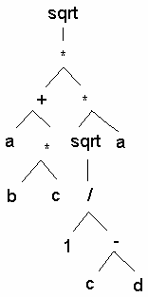
GEP
sqrt.*.+.*.a.*.sqrt.a.b.c./.1.-.c.d

Slide 5
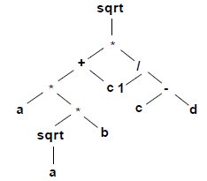
P-GEP
sqrt.*.+.*.a.*.sqrt.a.b.c./.1.-.c.d

Slide 6
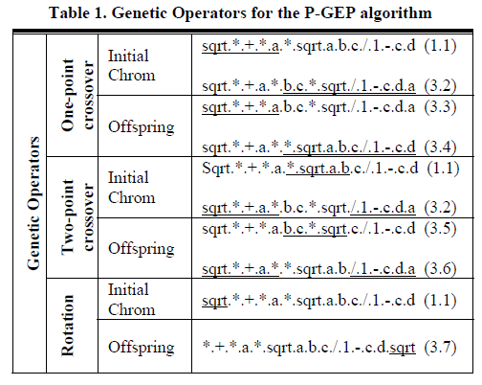
Genetic Operators

Slide 7
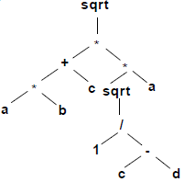
sqrt.*.+.*.a.*.sqrt.a.b.c./.1.-.c.d
sqrt.*.+.*.a.b.c. *. sqrt./.1.-.c. d.a

Slide 8
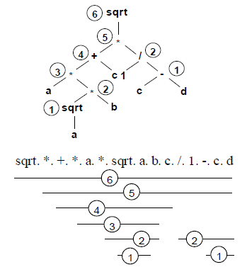

Slide 9
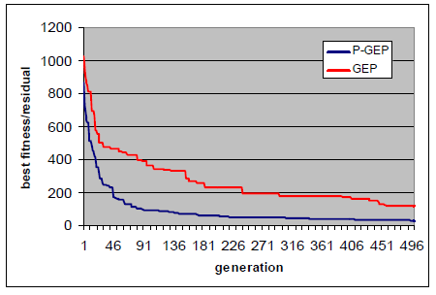
EXPERIMENTS
simple symbolic regression problem

Slide 10
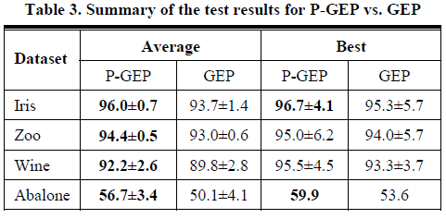
Classification tests

Slide 11
THE END

