Slide 1
Order Preserving Pattern Matching Revisited
Md. Mahbubul Hasan, A.S.M. Shohidull Islam, Mohammad Saifur Rahman, M. Sohel Rahman
Pattern Recognition Letters 55, 2015, pp.15-21
Presenter: Zhi-Cheng Shen
Date: July 10, 2023

Slide 2
Abstract
In this paper, we study the order preserving pattern matching (OPPM) problem, which is a very recent variant of the classic pattern matching problem. We revisit this variant, present a new interesting pattern matching algorithm and for the first time consider string regularities from this new perspective.

Slide 3
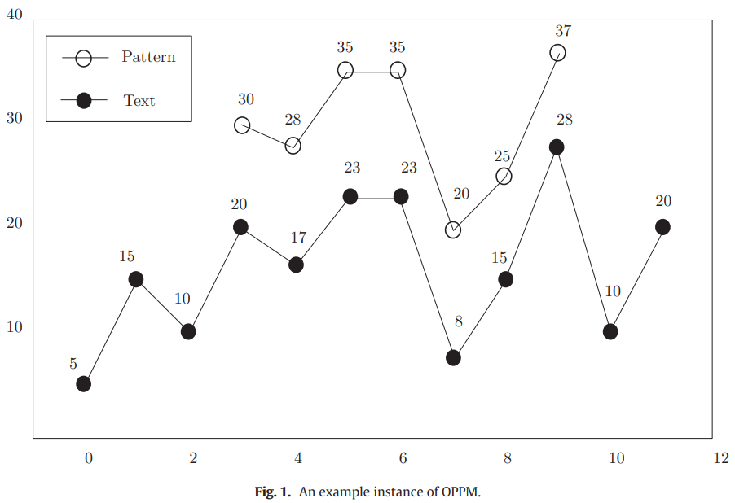
Order Preserving Pattern Matching (OPPM)

Slide 4

Z-Function

Slide 5

Modified Z-Function

Slide 6
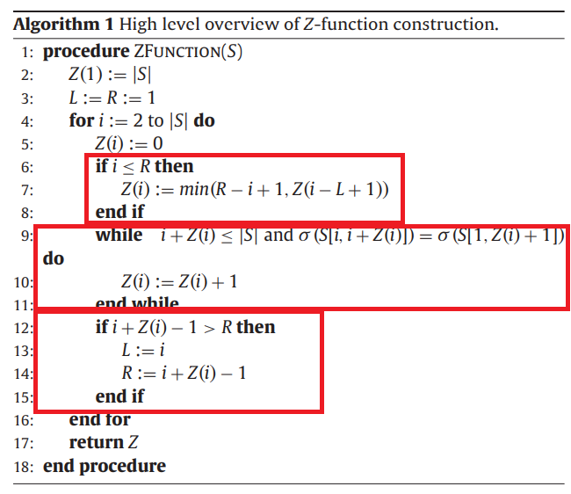
The reason for such bound of Z(i)is the fact that we always have σ (S[L, R]) = σ (S[1, R − L + 1]).

Slide 7
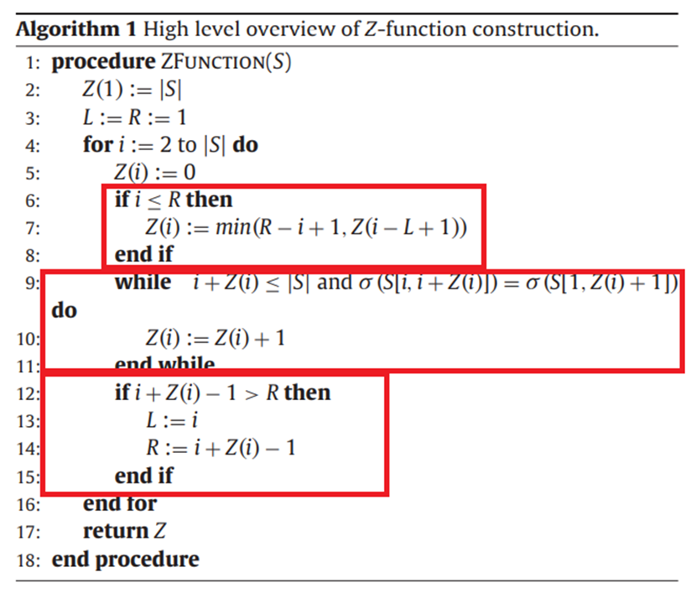
S | 11 | 18 | 24 | 20 | 25 | 29
Z(S) | 6
L
i
R
S | 1 | 5 | 7 | 3 | 20 | 50 | 70 | 30
Z(S) | 8 | 2 | 1 | 3 | 4 | 2

Slide 8
S | 11 | 18 | 24 | 20 | 25 | 29
Z(S) | 6 | 2 | 1 | 3 | 2 | 1
Prev | -∞ | 1 | 2 | 2 | 3 | 5
Next | ∞ | ∞ | ∞ | 3 | ∞ | ∞
Time Complexity: O(nlogn)

Slide 9
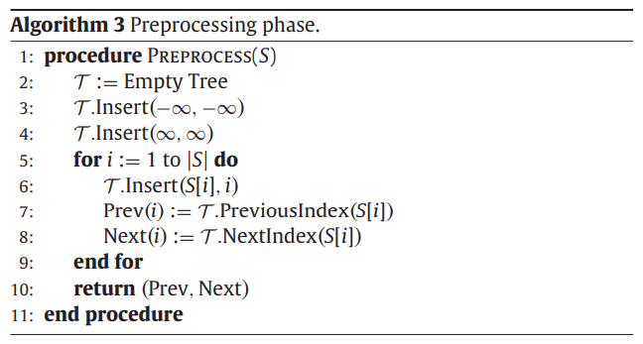

Slide 10
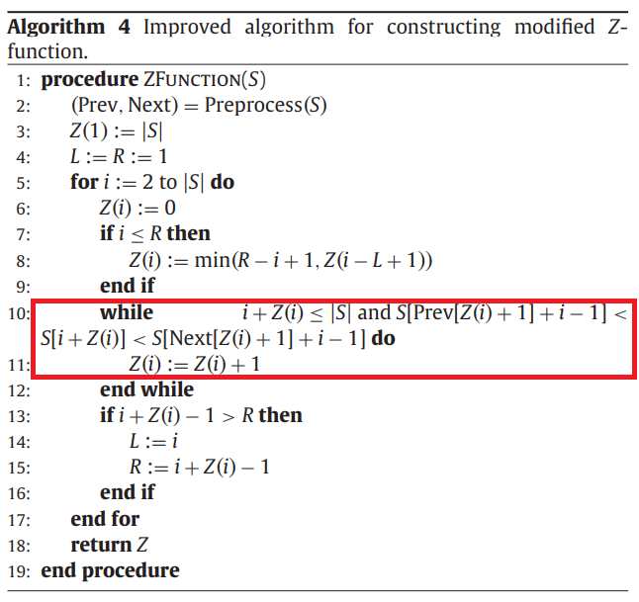

Slide 11
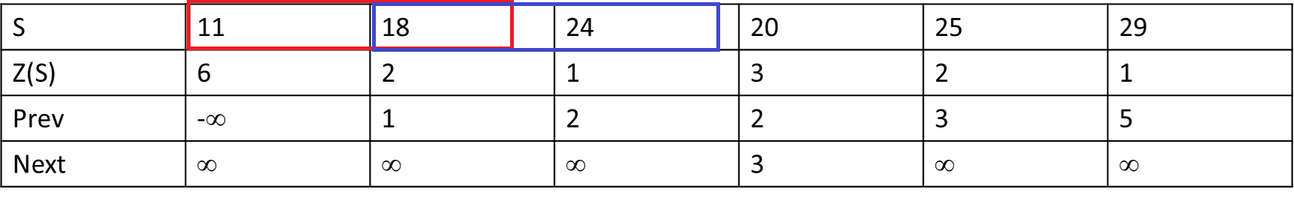
S[Prev[Z(i)+1] + (i-1)] < S[i+Z(i)] < S[Next[Z(i)+1] + (i-1)]
先求初前面那串“i”位置的Prev，再加上bias(i-1)跳到後面那串的相對index
i = 2:
S[Prev[1] + 1] = -∞, S[2+Z(2)] = 18, S[Next[1]+1] = ∞
-∞ < 18 < ∞
i = 3:
S[Prev[2]+1] = 18, S[2+Z(2)] = 24, S[Next[2]+1] = ∞
18 < 24 < ∞
i = 4:
S[Prev[3]+1] = 24, S[2+Z(2)] = 20, S[Next[3]+1] = ∞
24 < 20 < ∞ x

Slide 12
求出OPPM
P = [1,3,2,4], len(P) = 4
T = [11,18,24,20,25,29]
S = P + T
S | 1 | 3 | 2 | 4 | 11 | 18 | 24 | 20 | 25 | 29
Z(S) | 10 | 1 | 2 | 2 | 2 | 4 | 1 | 2 | 2 | 1

Slide 13
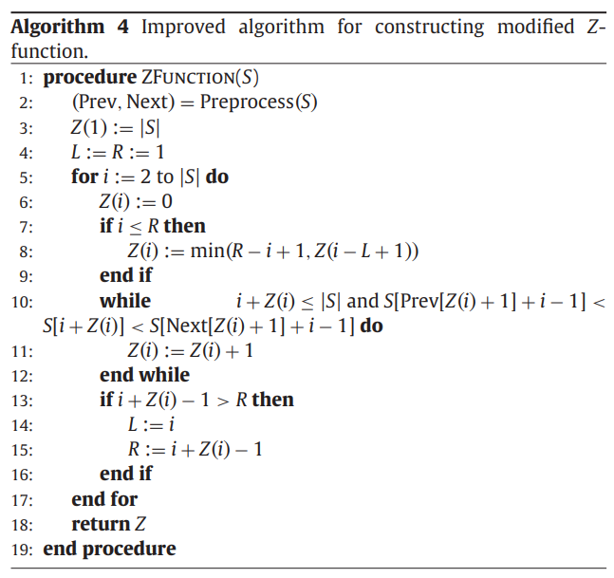
Time Complexity
Preprocess: O(nlogn)
While loop: R+O(n)
Total complexity: O(nlogn)

Slide 14
Thanks~

