Slide 1
A fast algorithm for computing a longest common increasing subsequence
I-Hsuan Yang, Chien-Pin Huang, Kun-Mao Chao.
Information Processing Letters 93 (2005) 249–253
Presenter: Wan-Ni Ou
Date: Sep. 3, 2024

Slide 2
Abstract
Let A = ⟨a₁, a₂,...,a_{m}⟩ and B = ⟨b₁, b₂,...,b_{n}⟩ be two sequences, where each pair of elements in the sequences is comparable.
A common increasing subsequence of A and B is a subsequence ⟨ a_{i1} = b_{j1} , a_{i2} = b_{j2} ,...,a_{il} = b_{jl}⟩, where i₁ < i₂ < ··· < i_{l} and j₁ < j₂ < ··· < j_{l}, such that for all 1 ≤ k<l, we have a_{ik} < a_{ik+1} .
A longest common increasing subsequence of A and B is a common increasing subsequence of the maximum length. This paper presents an algorithm for delivering a longest common increasing subsequence in O(mn) time and O(mn) space.

Slide 3
LCIS
A = ⟨3, 4, 2, 1, 3, 4, 6⟩
B = ⟨4, 3, 1, 4, 6⟩
LCIS= ⟨3, 4, 6⟩ 、⟨1, 4, 6⟩

Slide 4
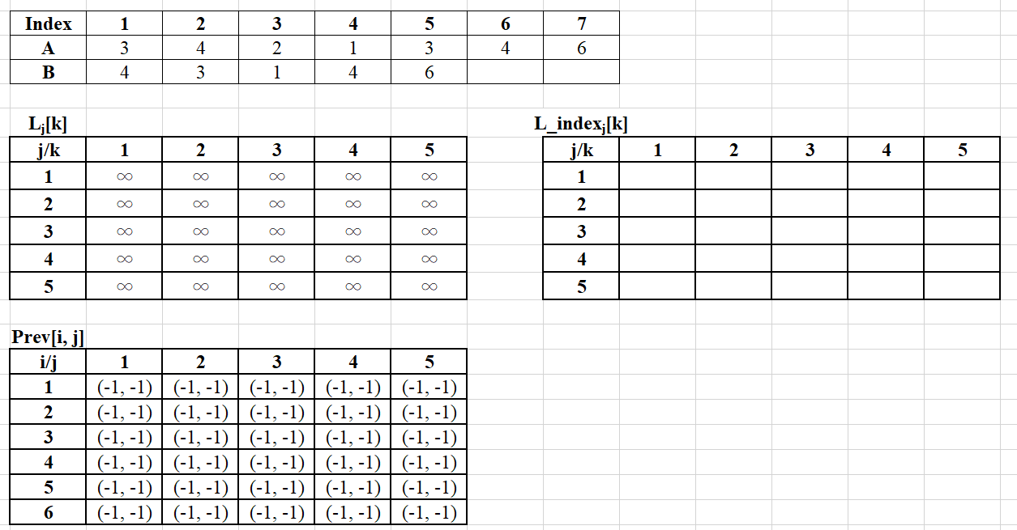
L_{j}[k]：紀錄各個長度最好的ending值
L_index_{j}[k]：兩個序列中相同元素的index
Prev[i, j]：紀錄前一個元素的index

Slide 5
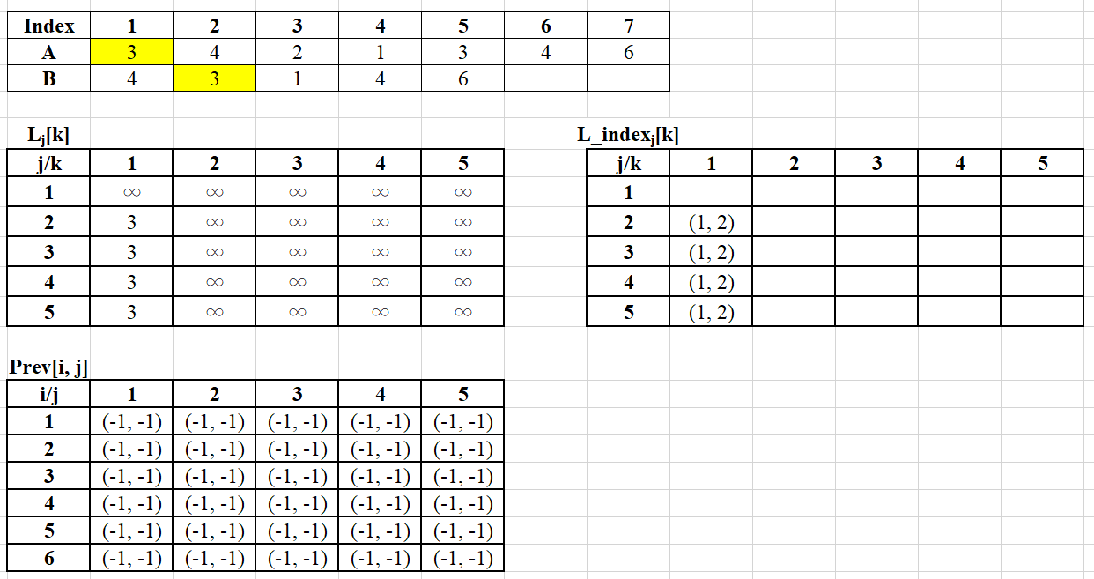
L_{j}[k]：紀錄各個長度最好的ending值
L_index_{j}[k]：兩個序列中相同元素的index
Prev[i, j]：紀錄前一個元素的index

Slide 6
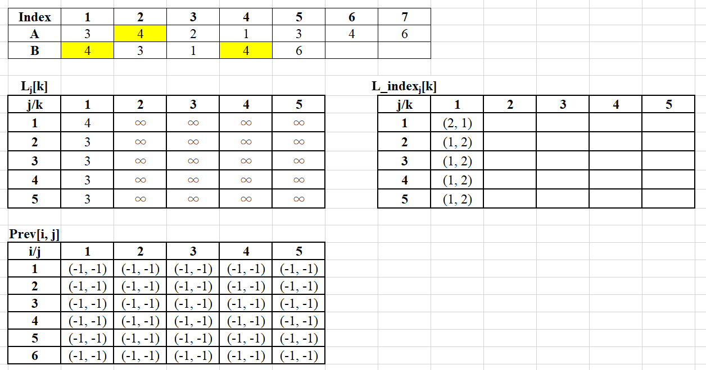
L_{j}[k]：紀錄各個長度最好的ending值
L_index_{j}[k]：兩個序列中相同元素的index
Prev[i, j]：紀錄前一個元素的index

Slide 7
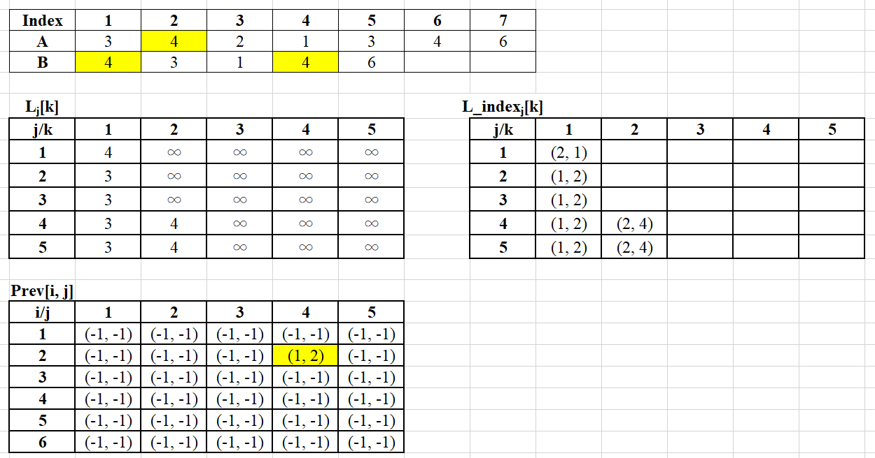
L_{j}[k]：紀錄各個長度最好的ending值
L_index_{j}[k]：兩個序列中相同元素的index
Prev[i, j]：紀錄前一個元素的index

Slide 8
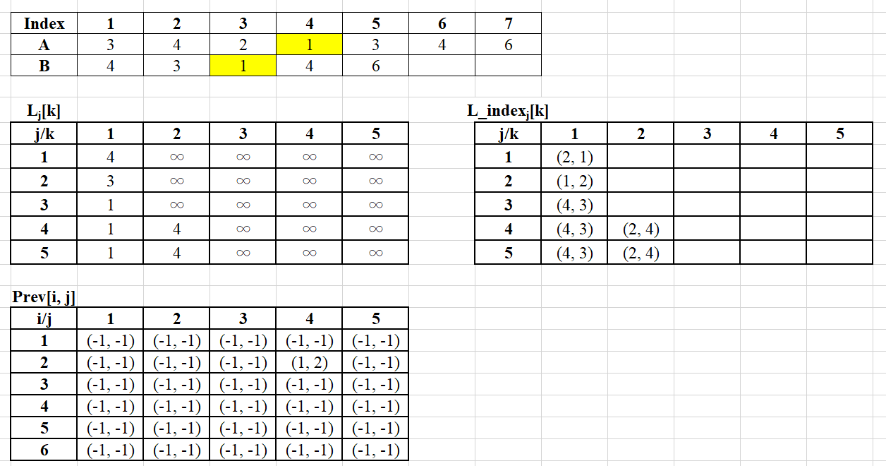
L_{j}[k]：紀錄各個長度最好的ending值
L_index_{j}[k]：兩個序列中相同元素的index
Prev[i, j]：紀錄前一個元素的index

Slide 9
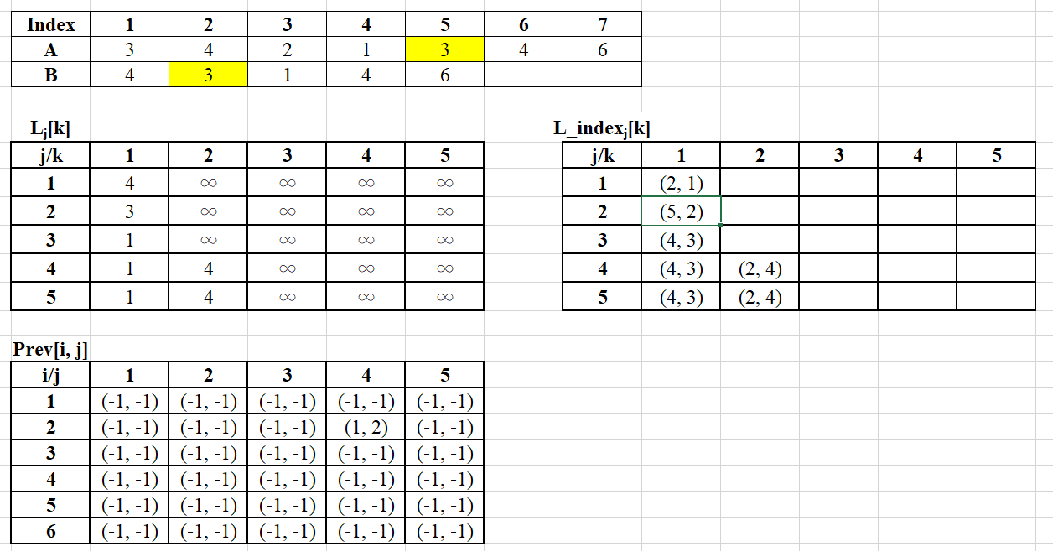
L_{j}[k]：紀錄各個長度最好的ending值
L_index_{j}[k]：兩個序列中相同元素的index
Prev[i, j]：紀錄前一個元素的index

Slide 10
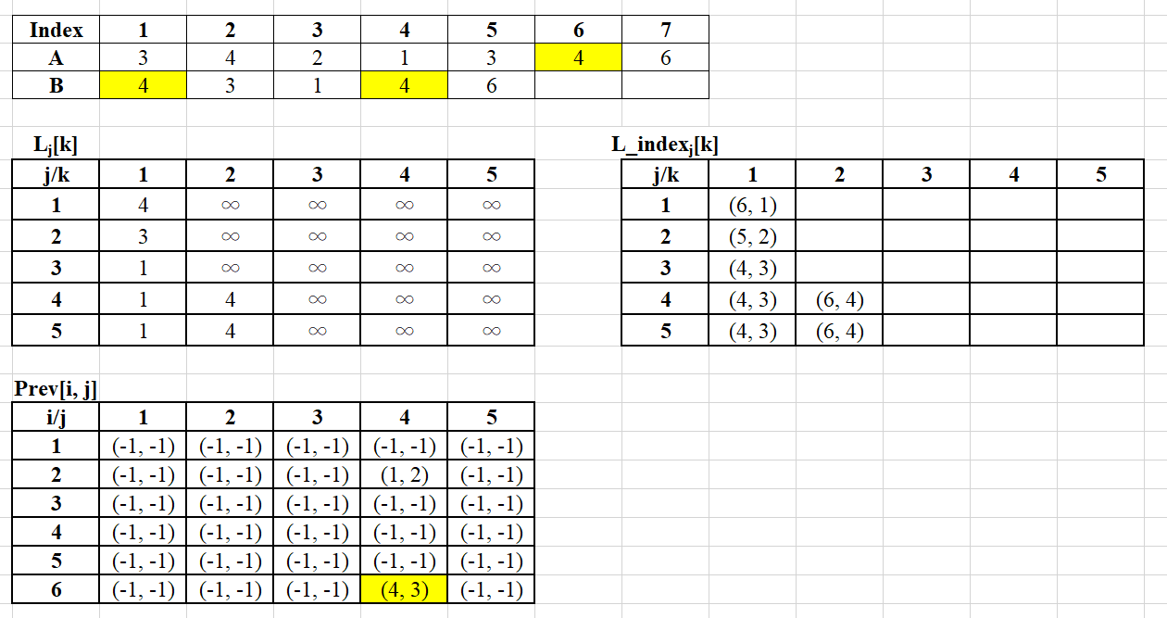
L_{j}[k]：紀錄各個長度最好的ending值
L_index_{j}[k]：兩個序列中相同元素的index
Prev[i, j]：紀錄前一個元素的index

Slide 11
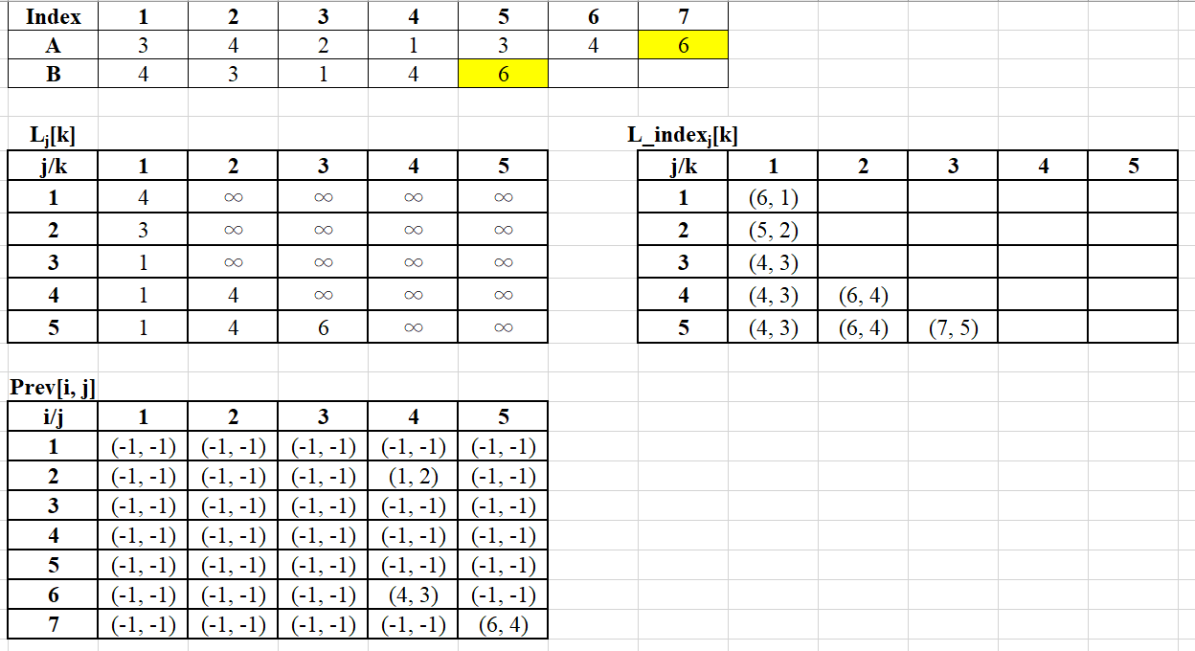
L_{j}[k]：紀錄各個長度最好的ending值
L_index_{j}[k]：兩個序列中相同元素的index
Prev[i, j]：紀錄前一個元素的index
1
4
6

Slide 12
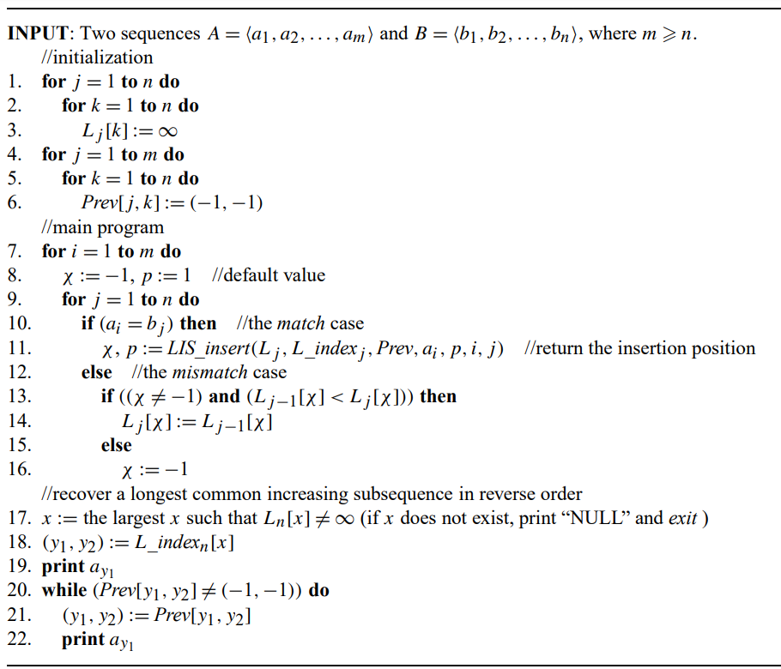
LCIS
Lj[k]
L_indexj[k]
Prev[i, j]

Slide 13
Conclusion
Proposed an algorithm that utilizes the folklore algorithm to solve LCIS problem.
Time Complexity: O(mn)
Space Complexity: O(mn)

Slide 14
Thanks

