Slide 1
Weighted dynamic time warping for time series classification
Jeong, Y. S., Jeong, M. K., & Omitaomu, O. A. (2011)
Pattern recognition
Presenter : Jing-Xiang Yang
Date : Sept 3, 2024

Slide 2
ABSTRACT(1)
Dynamic time warping (DTW), which finds the minimum path by providing non-linear alignments between two time series, has been widely used as a distance measure for time series classification and clustering. However, DTW does not account for the relative importance regarding the phase difference between a reference point and a testing point. This may lead to mis classification especially in applications where the shape similarity between two sequences is a major consideration for an accurate recognition. Therefore, we propose a novel distance measure, called a weighted DTW (WDTW), which is a penalty based DTW. Our approach penalizes points with higher phase difference between a reference point and a testing point in order to prevent minimum distance distortion caused by outliers. The rationale underlying the proposed distance measure is demonstrated with some illustrative examples.

Slide 3
ABSTRACT(2)
A new weight function, called the modified logistic weight function (MLWF), is also proposed to systematically assign weights as a function of the phase difference between a reference point and a testing point. By applying different weights to adjacent points, the proposed algorithm can enhance the detection of similarity between two time series. We show that some popular distance measures such as DTW and Euclidean distance are special cases of our proposed WDTW measure. We extend the proposed idea to other variants of DTW such as derivative dynamic time warping (DDTW) and propose the weighted version of DDTW. We have compared the performances of our proposed procedures with other popular approaches using public data sets available through the UCR Time Series Data Mining Archive for both time series classification and clustering problems. The experimental results indicate that the proposed approaches can achieve improved accuracy for time series classification and clustering problems.

Slide 4
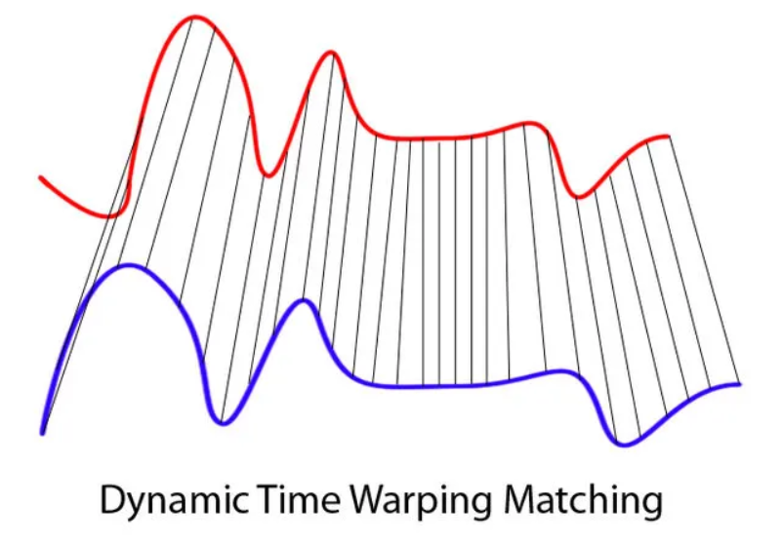
Dynamic Time Warping
Measuring similarity between two time series with different size
speaker recognition, signature recognition

Slide 5
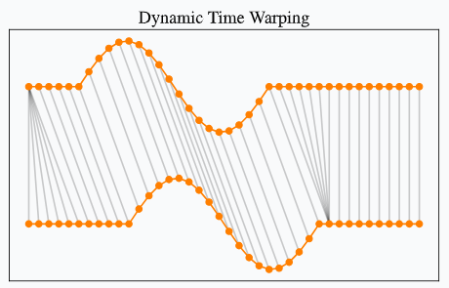
DTW
Boundary Condition
Monotonicity condition
p_{(k)} _{>=} p_{(k-1)}, q_{(k)} _{>=} q_{(k-1)}
Continuity condition
p_{(k)} ₋ p_{(k-1) >= 1}, q_{(k)} ₋ q_{(k-1) >= 1}

Slide 6
S = [12, 2, 2, 6, 7]
T = [11, 10, 1, 0]
12
2
2
6
7
1 | 9 | 9 | 5 | 4
2 | 8 | 8 | 4 | 3
11 | 1 | 1 | 5 | 6
12 | 2 | 2 | 6 | 7
11
10
1
0
Distance Matrix

Slide 7
DP
12
2
2
6
7
11
1 | 10 | 19 | 24 | 28
3
10
9
17
21
24
1
14
4
5
10
16
0
26
6
6
11
17

Slide 8
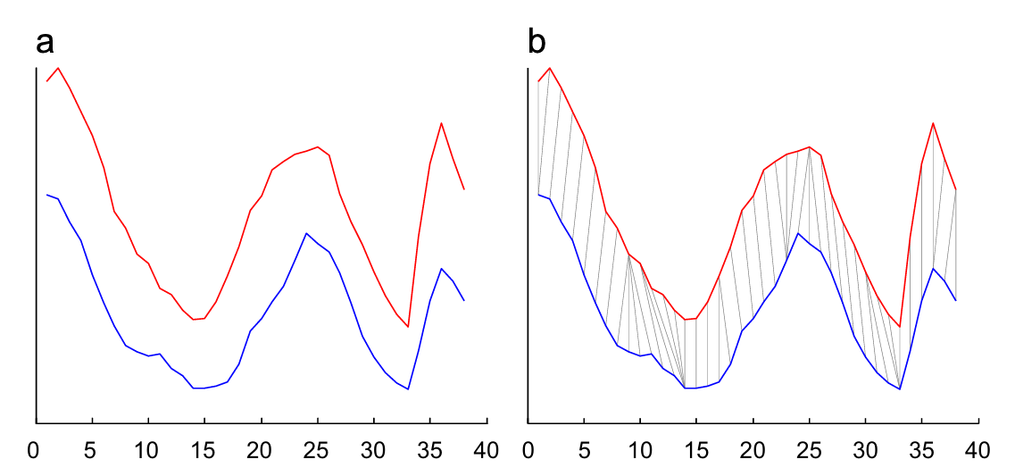
Problem of DTW
Conventional DTW equally weights all points between two series.
Ignore the importance of phase differences between reference and test points.
Singularity

Slide 9
WDTW
Penalizes points with larger phase differences between reference and test points.
Prevent a point in a sequence from mapping the further points in another one
Notes:
P = 範數
對第 ai 與 bj 求得的範數距離乘上一個權重

Slide 10
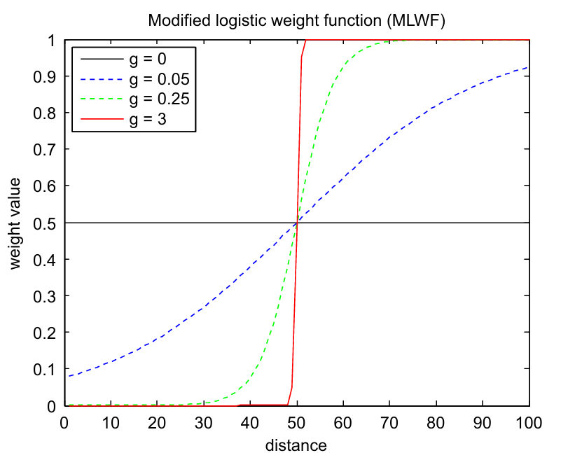
Modified logistic weight function (MLWF)
Wmax : upper bound of the weight
i : location in the sequence
mc : mid point of the sequence
g : level of penalization
Notes:
P = 範數
對第 ai 與 bj 求得的範數距離乘上一個權重

Slide 11
Modified logistic weight function (MLWF)
Smaller g Traditional DTW
Larger g Does not allow non-linear alignment
Notes:
P = 範數
對第 ai 與 bj 求得的範數距離乘上一個權重

Slide 12
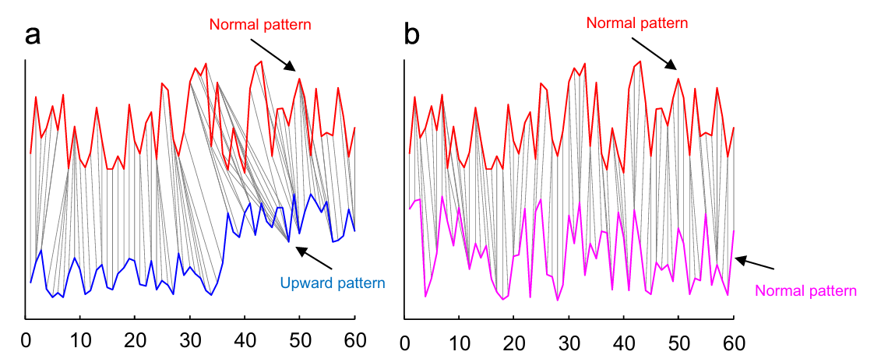
Experiment (DTW)
Distance
17.4 | 18.6
Notes:
P = 範數
對第 ai 與 bj 求得的範數距離乘上一個權重

Slide 13
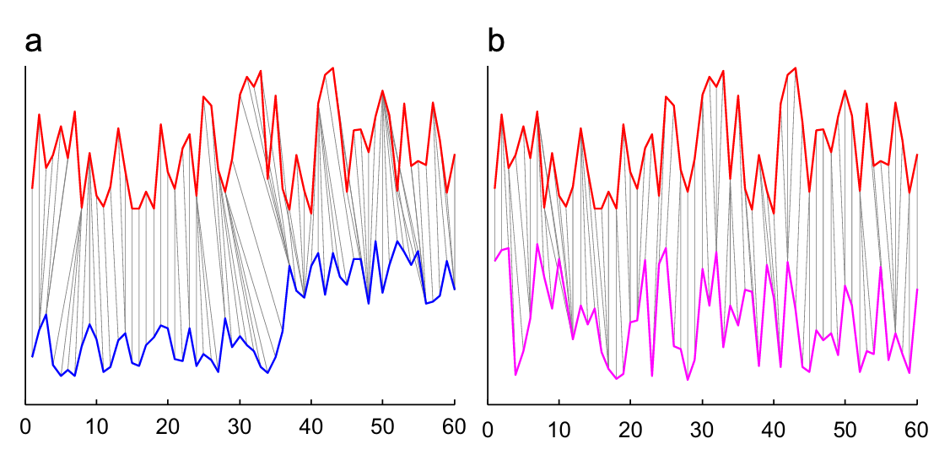
Experiment (WDTW)
Distance
0.134 | 0.123
Notes:
P = 範數
對第 ai 與 bj 求得的範數距離乘上一個權重

Slide 14
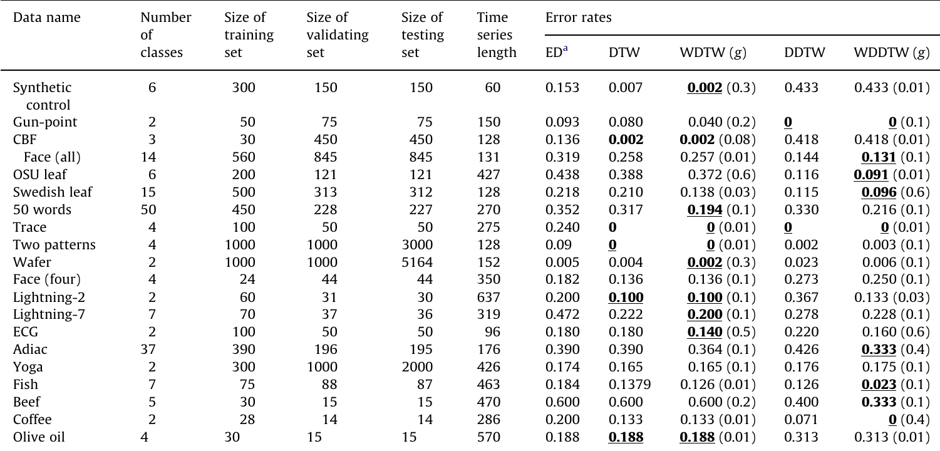
Experiment
Notes:
P = 範數
對第 ai 與 bj 求得的範數距離乘上一個權重

Slide 15
Experiment
Class A
Class B
70%
cluster
30%
Notes:
P = 範數
對第 ai 與 bj 求得的範數距離乘上一個權重

Slide 16
Thanks

