Slide 1
CCFinder: A Multilinguistic Token-Based Code Clone Detection System for Large Scale Source Code
Toshihiro Kamiya, Shinji Kusumoto,, and Katsuro Inoue
IEEE TRANSACTIONS ON SOFTWARE ENGINEERING, VOL. 28, NO. 7, JULY 2002, pp. 654-670
Presenter: Yu-Lin Chen
Date: Feb. 18, 2025

Slide 2
Abstract(1/2)
A code clone is a code portion in source files that is identical or similar to another. Since code clones are believed to reduce the maintainability of software, several code clone detection techniques and tools have been proposed. This paper proposes a new clone detection technique, which consists of the transformation of input source text and a token-by-token comparison. For its implementation with several useful optimization techniques, we have developed a tool, named CCFinder, which extracts code clones in C, C++, Java, COBOL, and other source files. As well, metrics for the code clones have been developed.

Slide 3
Abstract(2/2)
In order to evaluate the usefulness of CCFinder and metrics, we conducted several case studies where we applied the new tool to the source code of JDK, FreeBSD, NetBSD, Linux, and many other systems. As a result, CCFinder has effectively found clones and the metrics have been able to effectively identify the characteristics of the systems. In addition, we have compared the proposed technique with other clone detection techniques.

Slide 4
Clone relation defined
A clone relation holds between two code portions if (and only if) they are the same sequences.
For a given clone relation, a pair of code portions is called clone pair if the clone relation holds between the portions.
a clone class is a maximal set of code portions in which a clone relation holds between any pair of code portions

Slide 5
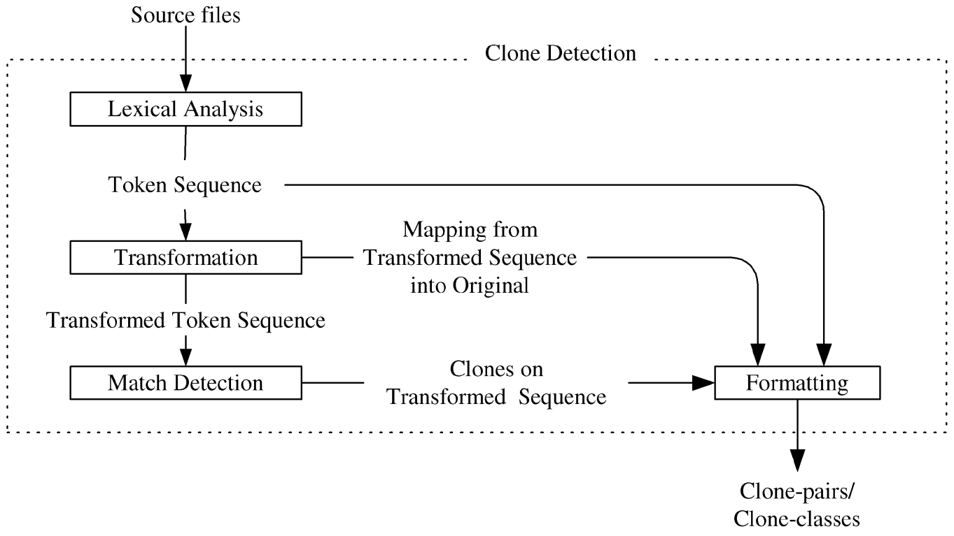
Clone detecting process

Slide 6
Lexical Analysis
Each line of source files is divided into tokens corresponding to a lexical rule of the programming language.
The white spaces (including \n and \t and comments) between tokens are removed from the token sequence

Slide 7
Transformation(Rules for C++)
Rule | Rule description
Remove namespace arrtibution | (Name '::')+ Name2 → Name2 Ex: std::ios_base::hex is transformed into hex
Remove template parameters | Name '<' ParameterList '>' → Name Ex: sort<int> is transformed into sort
Remove initialization lists | '=' '{' InitializationList, '}' → '=' '{' UniqueIdentifier '}' Ex: = {1, 2, 3} is transformed into = {UniqueIdentifier}
Separate function definitions | Insert UniqueIdentifier at the end of each top-level definition and declaration.
Remove accessibility keywords | AccessibilityKeyword → ∅ (where ∅ represents a null sequence) Ex: protected: void foo(); is transformed into void foo();
Convert to compound block | Each single statement after if(), do, else, for(), and while() is transformed to a compound block. Ex: if (a == 1) b = 2; is transformed into if (a == 1) { b = 2; }

Slide 8
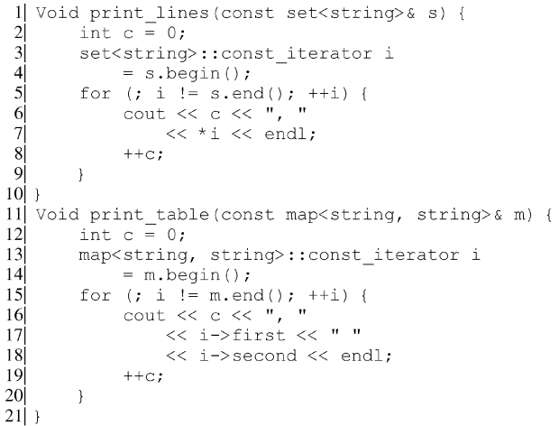
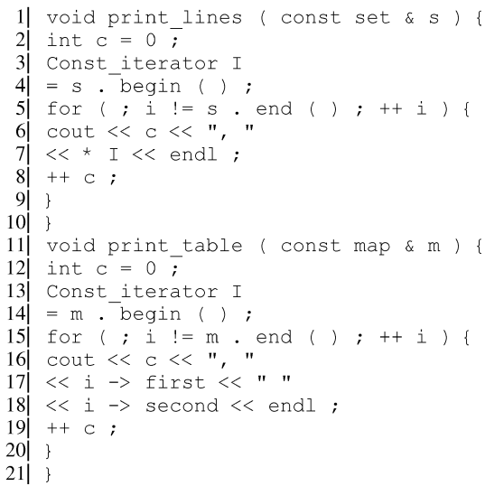
Example
Sample code.
The transformed code by the transformation rules.

Slide 9
Match Detection
From all the substrings on the transformed token sequence, equivalent pairs are detected as clone pairs.
Each clone pair is represented as a quadruplet (LeftBegin, LeftEnd, RightBegin, RightEnd), where LeftBegin and LeftEnd are the beginning and termination positions (indices in the token sequence) of a leading clone, and RightBegin and RightEnd belong to another following clone for a clone pair.
Ex: (1, 3, 5, 7)、(1, 3, 12, 14)、(5, 7, 12, 14)

Slide 10
Metrics for Evaluating Clone Pairs and Classes
LEN(p) is the length of a code portion of p
LEN(C) for clone class C is the maximum LEN(p) for each p in C
LOC (the number of lines, including null and comment lines)
SLOC (the number of lines, except null or comment lines)
POP(C) is the number of elements of a given clone class C
USELEN(C) amount of unique code in clone class C
DFL(C) amount of duplicated code in clone class C
old LOC total lines of code for clone class C before refactoring
new LOC total lines of code for clone class C after refactoring,

Slide 11
Metrics for Evaluating Clone Pairs and Classes
DFL measures an impact in size of reduction of each clone class
COVERAGE (% LOC) is the percentage of lines that include any portion of clone
COVERAGE (% FILE) is the percentage of files that include any clones
RAD(C) as the maximum length of path from each file F to the lowest common ancestor directory of all files in F

Slide 12
Metrics for Evaluating Clone Pairs and Classes
DFL(C) = (old LOC related to C) - (new LOC related to C)
= LEN(C) x POP(C) - (USELEN(C) x POP(C) + LEN(C))
COVERAGE (% LOC) = (Clone LOC / Total LOC) x 100%
RAD(C) = max(End)−min(Begin)

Slide 13
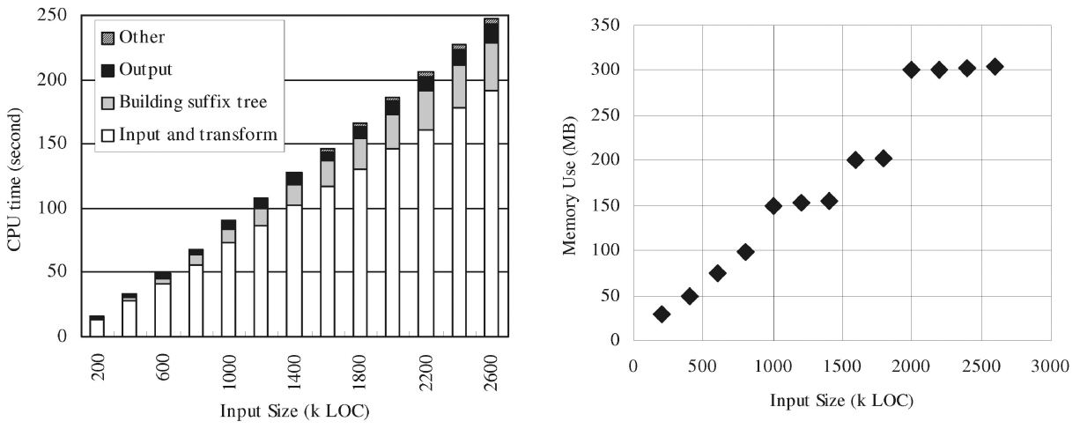
Implementation Techniques of Tool CCFinder

Slide 14
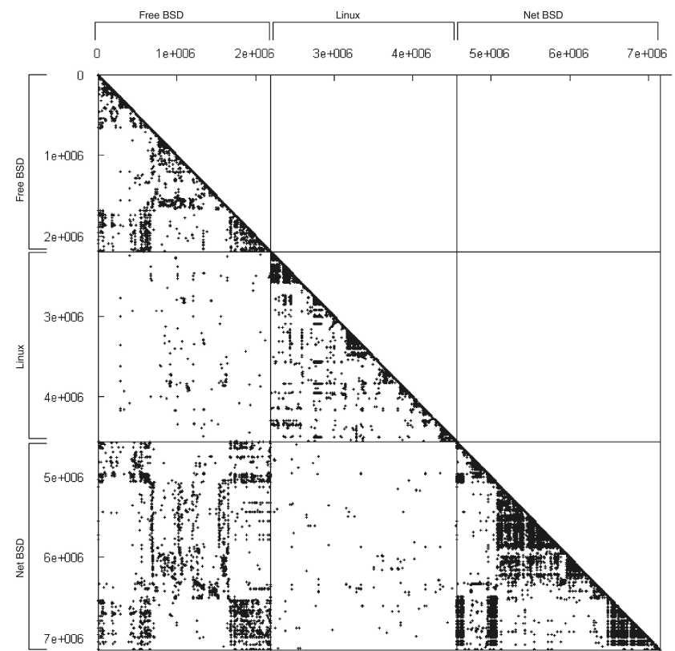
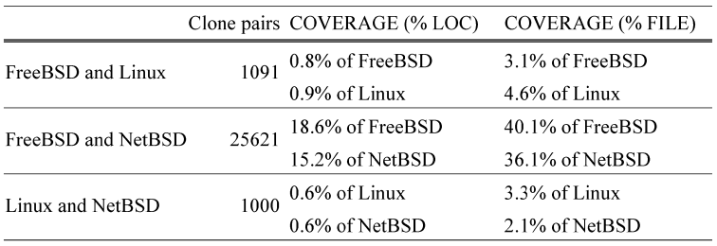
CASE STUDIES
Scatter plot of clones over 30 token among three operating systems.

Slide 15
Thanks

