Slide 1
Orthogonal Vectors and Related Problems
Deepanshu Kush
Presenter: Yen-Yu Chen
Date: Mar. 4, 2025

Slide 2
Abstract
In the remainder of section 1, we define the Orthogonal Vectors problem and discuss its trivial algorithms. We also state the Orthogonal Vectors Conjecture and Strong Exponential Time Hypothesis and explore their connections. In section 2, we define Partial Match and Subset Query and show their equivalences to Orthogonal Vectors. Further, we discuss a novel generalization of such kinds of problems andprove a dichotomy result based on a graph theoretic characterization: in some casesthis generalized problem is at least as hard as Orthogonal Vectors and in the rest, it can be solved in almost linear time. In section 3, we discuss a faster-than-trivial algorithm for Orthogonal Vectors due to Abboud, Williams, and Yu [AWY15], motivating every step along the way. In section 4, we show that listing (almost) all orthogonal pairs is subquadratically equivalent to detecting even a single orthogonal pair. Finally in section 5, we discuss a few natural extensions that can be explored.

Slide 3

Orthogonal
Given two vectors $u,v∈{\left\{0,1\right\}}^{d}$, we say that they are orthogonal if $\sum_{i=1}^{d}{u_{i}v_{i}}=0$
0 | 1 | 0 | 0 | 1 | 0
1 | 0 | 1 | 0 | 0 | 1

Slide 4

Orthogonal Vector Problem, OVP
Input: Lists A, B of N d-dimensional 0-1 vectors each.
Output: A pair $u∈A$and $v∈B$such that u and v are orthogonal, if such a pair exists.

Slide 5
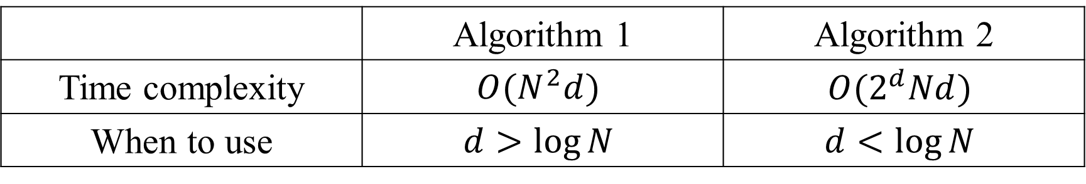
Algorithm for solving OVP
 | Algorithm 1 | Algorithm 2
Time complexity | $$O(N^{2}d)$$ | $$O(2^{d}Nd)$$
When to use | $$d>\log{N}$$ | $$d<\log{N}$$

Slide 6
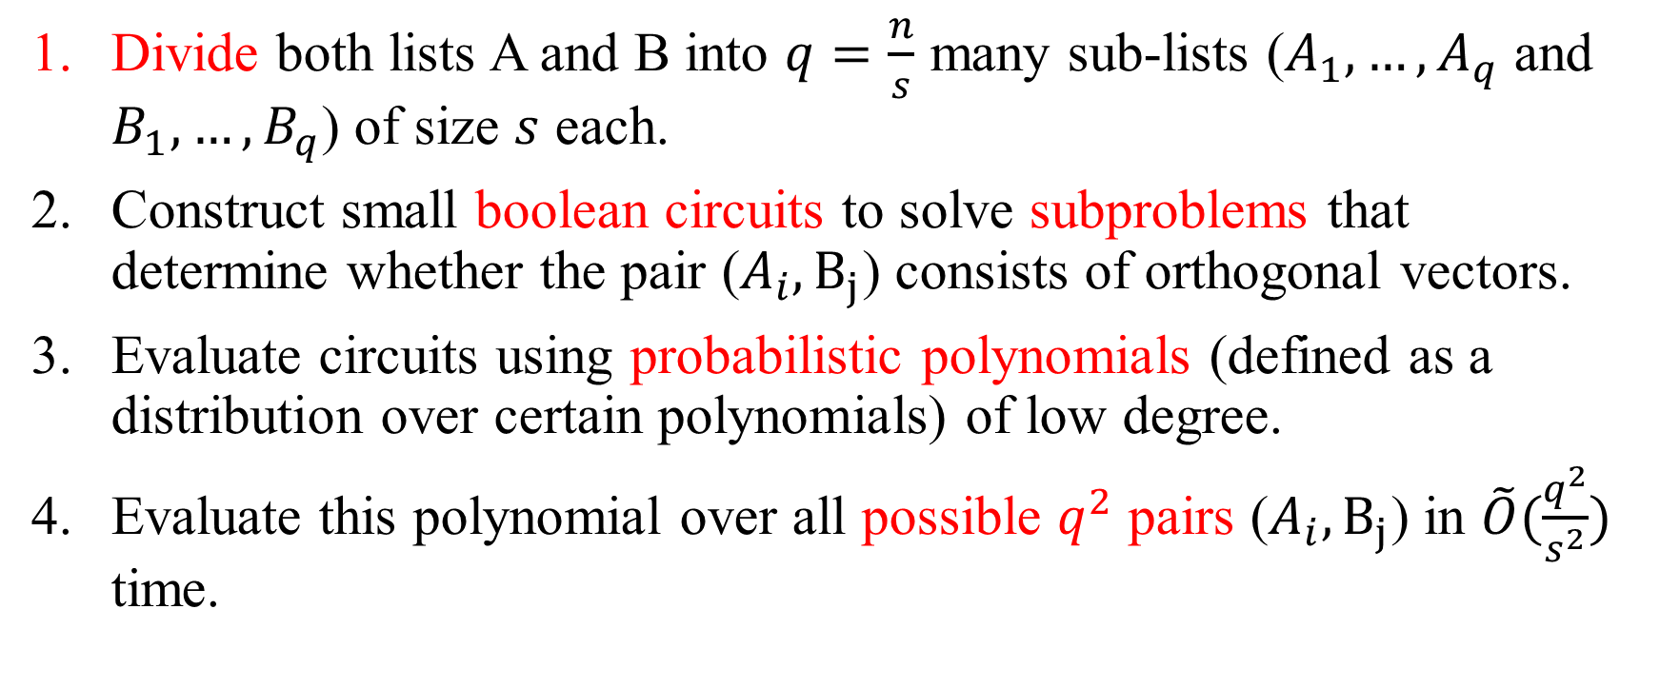
A fast algorithm for Orthogonal Vectors
Divide both lists A and B into $q=\frac{n}{s}$ many sub-lists ($A_{1},…,A_{q}$ and $B_{1},…,B_{q}$) of size $s$ each.
Construct small boolean circuits to solve subproblems that determine whether the pair ($A_{i},B_{j}$) consists of orthogonal vectors.
Evaluate circuits using probabilistic polynomials (defined as a distribution over certain polynomials) of low degree.
Evaluate this polynomial over all possible $q^{2}$ pairs ($A_{i},B_{j}$) in $\tilde{O}(\frac{q^{2}}{s^{2}})$ time.

Slide 7
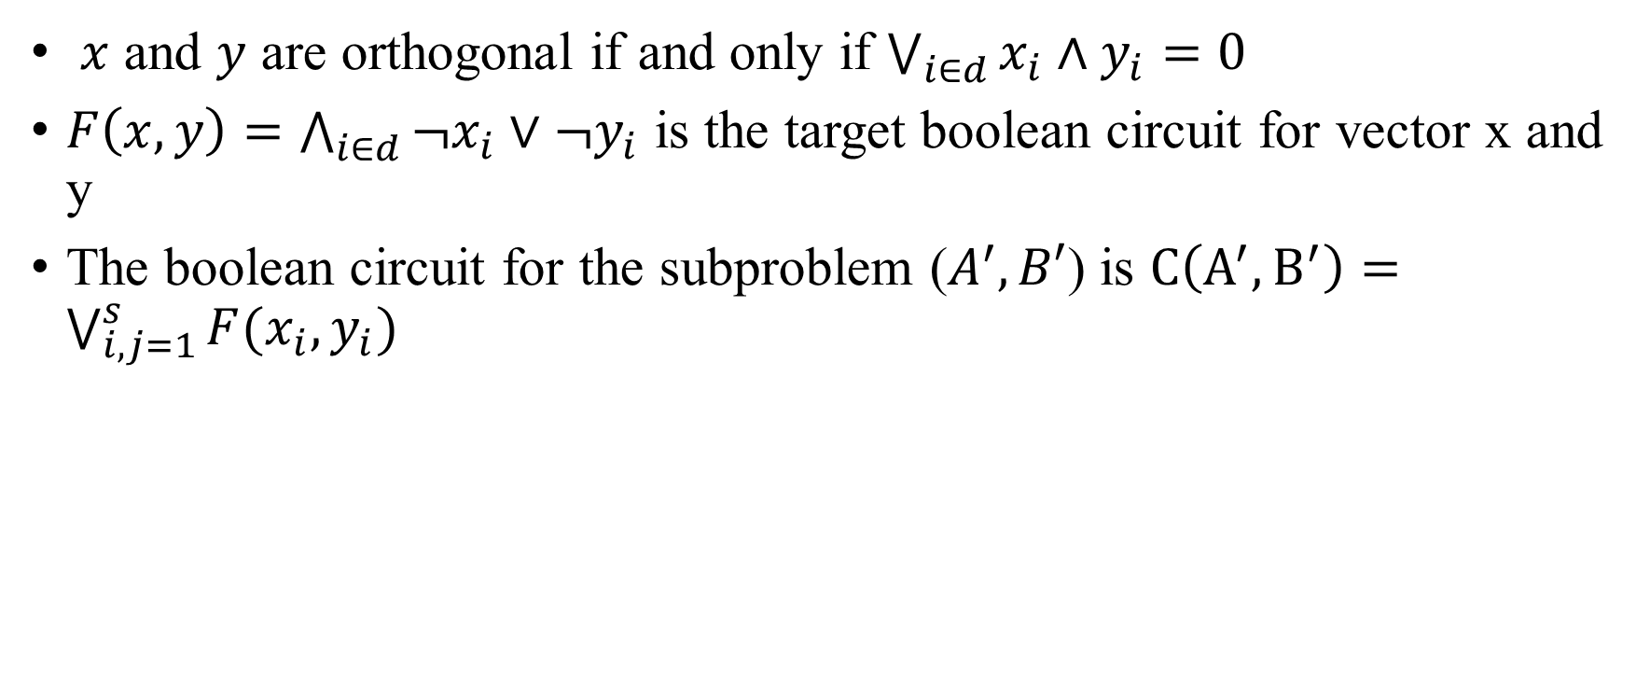
Step 2: Construct Boolean circuits
$x$ and $y$ are orthogonal if and only if $\bigvee_{i∈d}{x_{i}∧y_{i}}=0$
$F\left(x,y\right)=\bigwedge_{i∈d}{¬x_{i}∨¬y_{i}}$ is the target boolean circuit for vector x and y
The boolean circuit for the subproblem ($A^{′},B′$) is $C\left(A^{′},B^{′}\right)=\bigvee_{i,j=1}^{s}{F(x_{i},y_{i})}$

Slide 8
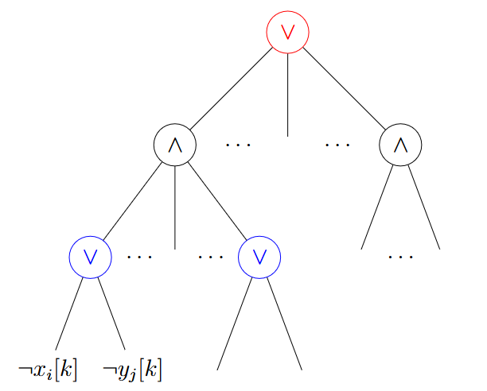
Boolean circuits

Slide 9

Step 3: Evaluate circuits using probabilistic polynomials
Evaluate Boolean circuit $C\left(A^{′},B^{′}\right)=\bigvee_{i,j=1}^{s}{F(x_{i},y_{i})}$ to probabilistic polynomial by tool (Razborov and Smolensky)

Slide 10

probabilistic polynomial
Compute OR of the bits $y_{1},…,y_{d}$by evaluating a polynomial over $Ϝ_{2}$
d times multiplication

Slide 11
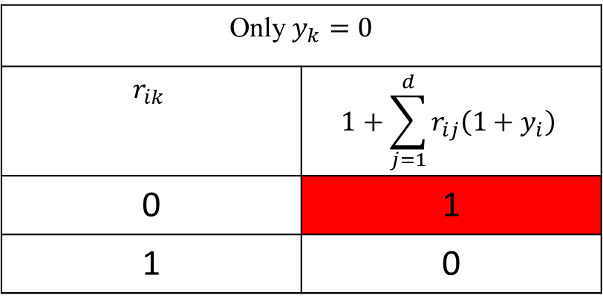
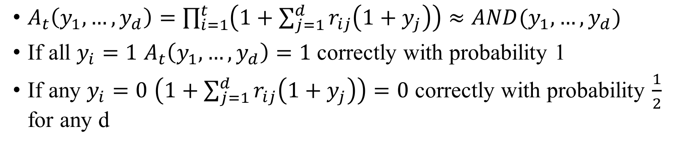
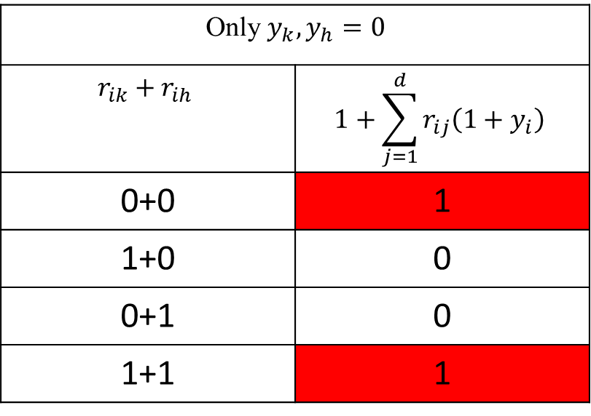
probabilistic polynomial example
$A_{t}\left(y_{1},…,y_{d}\right)=\prod_{i=1}^{t}{\left(1+\sum_{j=1}^{d}{r_{ij}\left(1+y_{j}\right)}\right)}≈AND(y_{1},…,y_{d})$
If all $y_{i}=1$ $A_{t}\left(y_{1},…,y_{d}\right)=1$ correctly with probability 1
If any $y_{i}=0$ $\left(1+\sum_{j=1}^{d}{r_{ij}\left(1+y_{j}\right)}\right)=0$ correctly with probability $\frac{1}{2}$ for any d
Only $y_{k},y_{h}=0$
$$r_{ik}+r_{ih}$$ | $$1+\sum_{j=1}^{d}{r_{ij}\left(1+y_{i}\right)}$$
0+0 | 1
1+0 | 0
0+1 | 0
1+1 | 1
Only $y_{k}=0$
$$r_{ik}$$ | $$1+\sum_{j=1}^{d}{r_{ij}\left(1+y_{i}\right)}$$
0 | 1
1 | 0

Slide 12
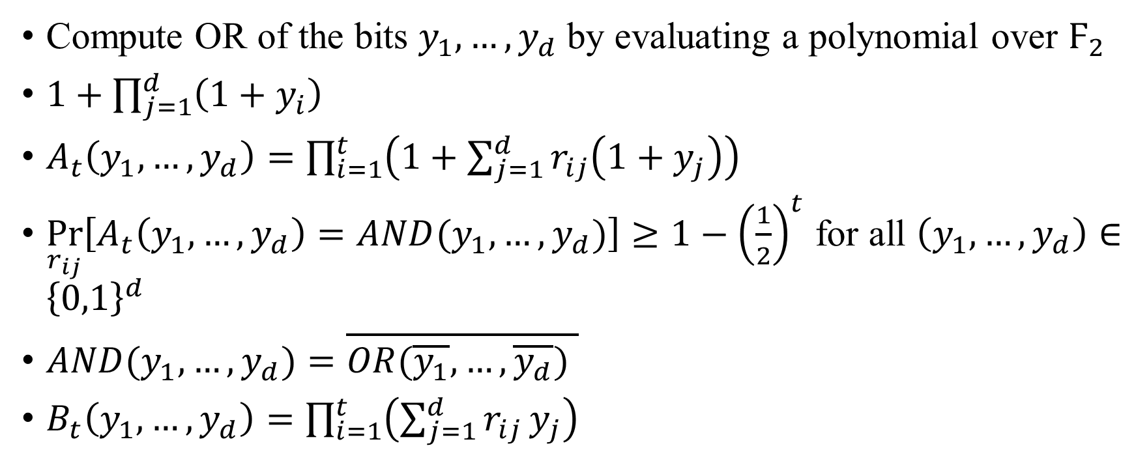
probabilistic polynomial
Compute OR of the bits $y_{1},…,y_{d}$by evaluating a polynomial over $Ϝ_{2}$
$1+\prod_{j=1}^{d}{\left(1+y_{i}\right)}$
$A_{t}\left(y_{1},…,y_{d}\right)=\prod_{i=1}^{t}{\left(1+\sum_{j=1}^{d}{r_{ij}\left(1+y_{j}\right)}\right)}$
$\underset{r_{ij}}{Pr}\left[A_{t}\left(y_{1},…,y_{d}\right)=AND(y_{1},…,y_{d})\right]≥1−{\left(\frac{1}{2}\right)}^{t}$ for all $\left(y_{1},…,y_{d}\right)∈{\left\{0,1\right\}}^{d}$
$AND(y_{1},…,y_{d})=\overline{OR(\overline{y_{1}},…, \overline{y_{d}}) }$
$B_{t}\left(y_{1},…,y_{d}\right)=\prod_{i=1}^{t}{\left(\sum_{j=1}^{d}{r_{ij}}y_{j}\right)}$

Slide 13
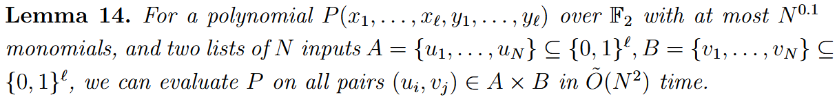
Coppersmith fast rectangular matrix multiplication for subproblem

Slide 14
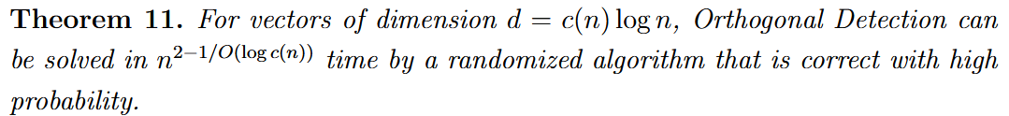
Time Complexity

