Slide 1
Longest Increasing Subsequence簡介
報告人：曾球庭
日期：2013/07/19

Slide 2
Longest Increasing Subsequence
The longest one among all increasing subsequences of a given string.
e.g. 4 1 5 7 3
4 1 7
1 3 5 7
4 7
1 5 7
4 5 7
are not increasing subsequences
are increasing subsequences
Find the longest among them

Slide 3
The Longest Increasing Subsequence (LIS) Problem
Definition:
  Input: One numeric sequence S
  Output: The longest increasing subsequence in S
Example: Given S = 35274816, the LIS in S is 3578.
By applying the LCS algorithm, this problem can be solved in O(n²) time. (Why?)
Robinson-Schensted-Knuth Algorithm can solve the LIS problem in O(nlogn) time.

Slide 4
LIS by LCS
 | - | 3 | 5 | 2 | 7 | 4 | 8 | 1 | 6
- | 0 | 0 | 0 | 0 | 0 | 0 | 0 | 0 | 0
1 | 0 | 0 | 0 | 0 | 0 | 0 | 0 | 1 | 1
2 | 0 | 0 | 0 | 1 | 1 | 1 | 1 | 1 | 1
3 | 0 | 1 | 1 | 1 | 1 | 1 | 1 | 1 | 1
4 | 0 | 1 | 1 | 1 | 1 | 2 | 2 | 2 | 2
5 | 0 | 1 | 2 | 2 | 2 | 2 | 2 | 2 | 2
6 | 0 | 1 | 2 | 2 | 2 | 2 | 2 | 2 | 3
7 | 0 | 1 | 2 | 2 | 3 | 3 | 3 | 3 | 3
8 | 0 | 1 | 2 | 2 | 3 | 3 | 4 | 4 | 4

Slide 5
Robinson-Schensted-Knuth Algorithm for LIS
Input
3
5
2
7
4
8
1
6
1
3
3
2
2
2
2
1
1
L
2
5
5
5
4
4
4
4
3
7
7
7
7
6
4
8
8
8
LIS: 3578
time complexity: O(nlogn)
  n numbers are inserted and each insertion takes O(logn) time for binary search.

Slide 6
Increasing Subsequence Representative (ISR)
The i-th element is the smallest ending symbol of increasing subsequences of S of length i.
For 41573, increasing subsequences are {4, 1, 5, 7, 3}, {45, 47, 15, 17, 13, 57} and {457, 157}, so ISR=137.
[Albe04]

Slide 7
Increasing Subsequence Representative
For every new element a_{i}, replace the smallest element larger than a_{i} in the previous ISR.
If we record the predecessor of each element when it is added, we can trace the LIS back step by step.
4 | 1 | 5 | 7 | 3
4 | 1 | 1 | 1 | 1
 |  | 5 | 5 | 3
 |  |  | 7 | 7
[Sche61]

Slide 8
Minimal Height Longest Increasing Subsequence (MHLIS)
Input: A string S.
Output: A longest increasing subsequence of S with minimal height.
Height: The difference between the largest number and the smallest number in an increasing sequence.
S’=457, height=7-4=3

Slide 9
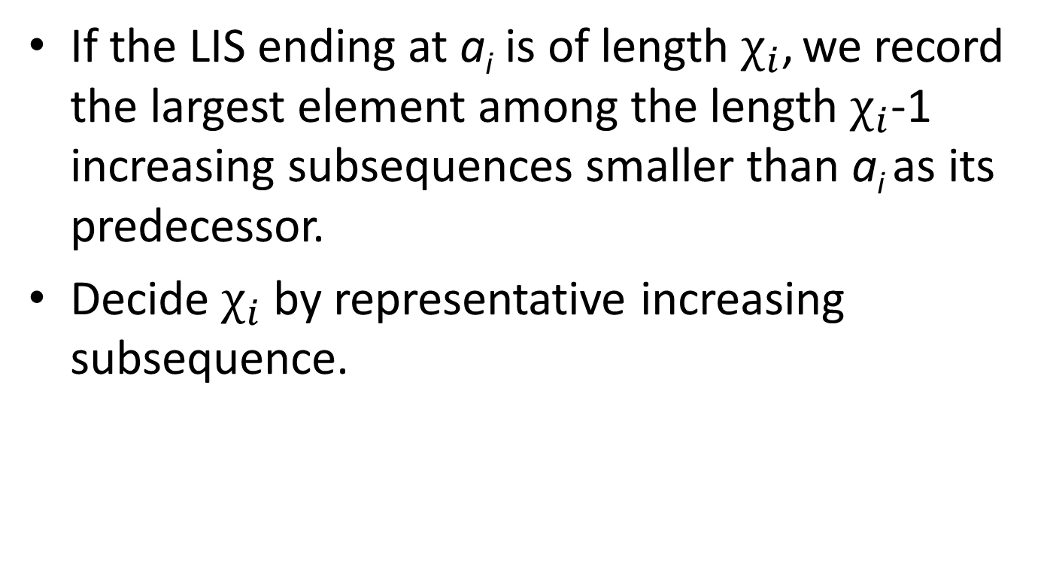
Algorithm
If the LIS ending at a_{i} is of length $χ_{i}$, we record the largest element among the length $χ_{i}$-1 increasing subsequences smaller than a_{i} as its predecessor.
Decide $χ_{i}$ by representative increasing subsequence.

Slide 10
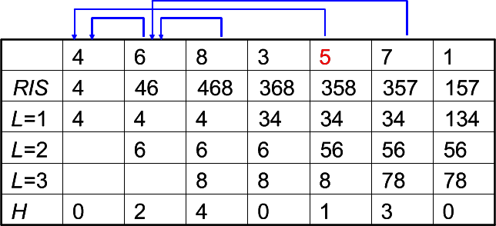
Example

Slide 11
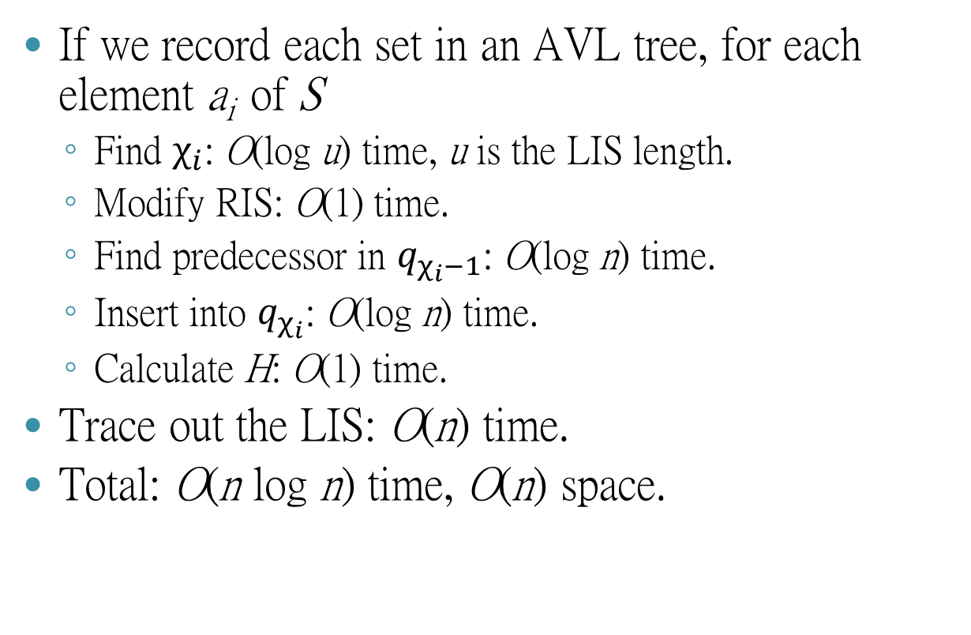
Time Complexity
If we record each set in an AVL tree, for each element a_{i} of S
  Find $χ_{i}$: O(log u) time, u is the LIS length.
  Modify RIS: O(1) time.
  Find predecessor in $q_{χ_{i}−1}$: O(log n) time.
  Insert into $q_{χ_{i}}$: O(log n) time.
  Calculate H: O(1) time.
Trace out the LIS: O(n) time.
Total: O(n log n) time, O(n) space.

Slide 12
Sequence Constrained Longest Increasing Subsequence (SCLIS)
Input: A string S and an increasing constraint C.
Output: A longest increasing subsequence of S containing C as its subsequence.
S=1529367, C=59→SCLIS=159 (LIS=12367)

Slide 13
Rule of Thumb
Elements greater than c_{i} can only appear after c_{i}.
Constraint c_{i} can only appear after all smaller constraints have already appeared.

Slide 14
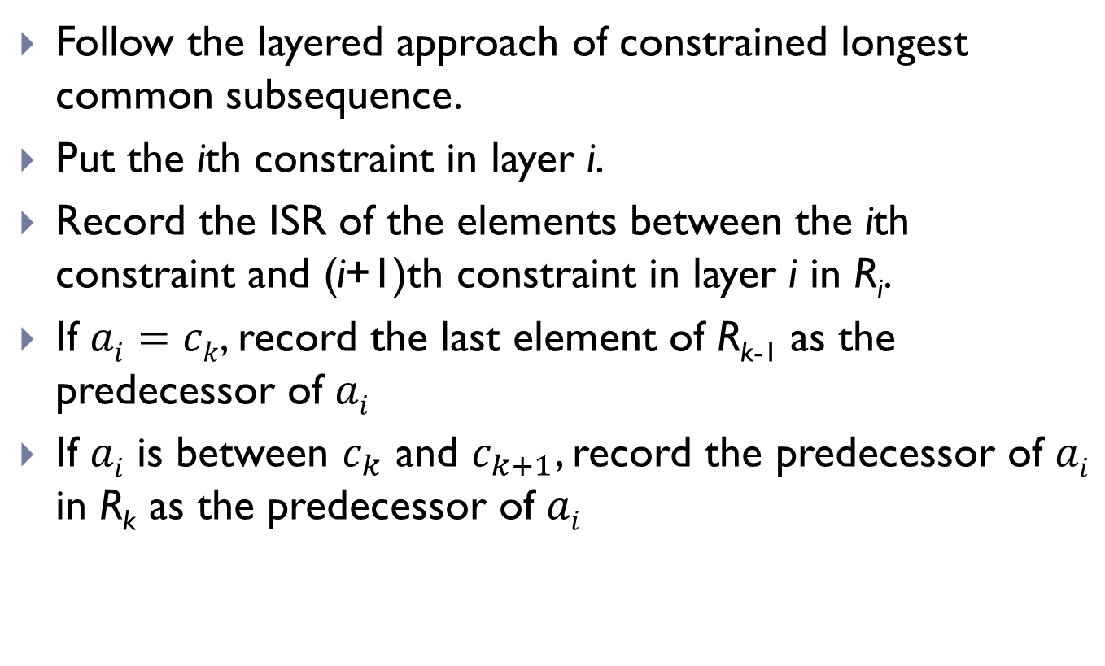
Algorithm
Follow the layered approach of constrained longest common subsequence.
Put the ith constraint in layer i.
Record the ISR of the elements between the ith constraint and (i+1)th constraint in layer i in R_{i}.
If $ai=ck$, record the last element of R_{k-1} as the predecessor of $ai$
If $ai$ is between $c_{k}$ and $c_{k+1}$, record the predecessor of $ai$ in R_{k} as the predecessor of $ai$
[Peng03]

Slide 15
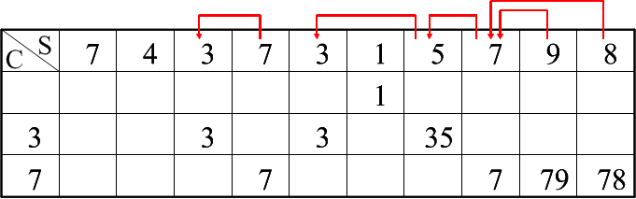
Example 1
S=7437315798, C=37
SCLIS=3578

Slide 16
Time Complexity
If we use array to do the implementation.
For each element in S
  Binary search on C: O(log r).
  Modify the ISR: O(log n).
  Set predecessor: O(1).
Trace out the CLIS: O(n) time.
Totally O(n log (n+r)) time, O(n) space

Slide 17
Time Complexity
Record each row in a van Emde Boas priority queue.
Spend O(n log n) time to sort, so we can transfer the input to [1, n].
Preprocessing: O(n² log log n) time for insert and predecessor.
Query: O(r + |OUTPUT|) time.

Slide 18
LIS in Sliding Windows
Longest Increasing Subsequences in Sliding Windows. Theoretical Computer Science 321 (2004) 405–414
Find an LIS for all sliding windows (fix length).
O(nloglogn + nl)

Slide 19
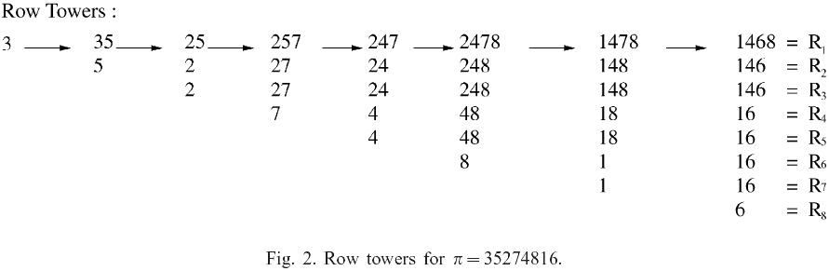
Row tower(1)
Input string=35274816

Slide 20
Row Tower(2)
Input string=35274816

Slide 21
Row Tower(3)
A naïve implementation of the data structure using a van Emde Boas priority queue for each row takes O(1) time for expiring, O(wloglogn) time for adding each element and O(1) time for outputting the length of each subsequence. Total time complexity would be O(nwloglogn), space complexity O(nw).

Slide 22
Data structure(1)
d sequence：used to record the valid range of every element.
σ sequence：used to record the sequence of expiration.
Principle row：used to record the LIS of the entire substring.
m sequence：number of duplicate rows.

Slide 23
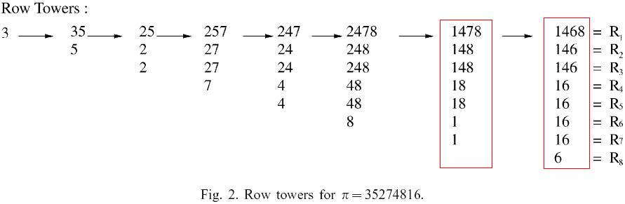
Data Structure(2)
PR = (1,4,6,8)
m = (1,2,4,1)
d = (7,3,8,1)
σ= (3,2,4,1)
PR = (1,4,7,8)
m = (1,2,2,2)
d = (7,3,1,5)
σ= (4,2,1,3)

Slide 24
Add
i_{t+1} is the least index larger than i_{t} for which d(i_{t+1})>d(i_{t} ), the sequence d is updated according to:
d(i_{t+1}) = d(i_{t}) for t = 1,2… k-1, (means “shift”)
d(i₁) = w + 1:
Similarly, the update of σ is
σ(i_{t+1}) = σ(i_{t}) for t = 1,2…k-1, (also means “shift”)
σ(i₁) = l
→ This operation cost O(l), where l is the length of LIS in the processing window

Slide 25
Example(1)
Input Sequence=35274816
d=(1)
σ=(1)
d=(1,2)
σ=(1,2)
d=(3,1)
σ=(2,1)
d=(3,1,4)
σ=(2,1,3)
d=(3,5,1)
σ=(2,3,1)

Slide 26
Example(2)
Input sequence=35274816
d=(3,5.1)
σ=(2,3,1)
d=(3,5,1,6)
σ=(2,3,1,4)
d=(7,3,1,5)
σ=(4,2,1,3)
d=(7,3,8,1)
σ=(3,2,4,1)

Slide 27
Expire
The expire operation simply subtracts 1 from each element of d and deletes the element with expiry time 0 (if there is one) from R. If no deletion occurs then σ is unchanged. Otherwise, the element 1 is deleted from σ and the remaining values are decreased by 1.
→ This operation cost O(l), where l is the length of LIS in the processing window

Slide 28
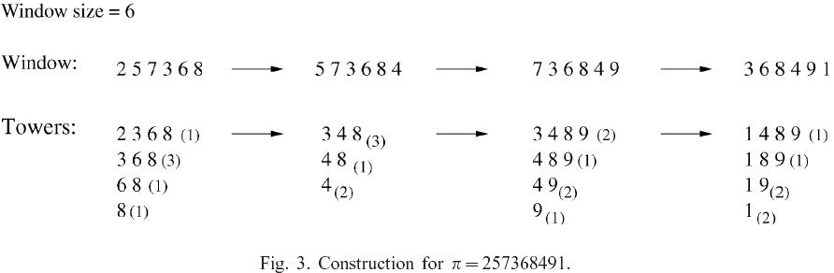
An Example
PR=(2,3,6,8)
m=(1,3,1,1)
d=(1,4,5,6)
σ=(1,2,3,4)
PR=(3,4,8)
m=(3,1,2)
d=(3,6,4)
σ=(1,3,2)
PR=(3,4,8,9)
m=(2,1,2,1)
d=(2,5,3,6)
σ=(1,3,2,4)
PR=(1,4,8,9)
m=(1,1,2,2)
d=(6,1,2,4)
σ=(4,1,2,3)
EXP
ADD
EXP
ADD
EXP
ADD
PR=(3,6,8)
m=(3,1,1)
d=(3,4,5)
σ=(1,2,3)
PR=(3,4,8)
m=(2,1,2)
d=(2,5,3)
σ=(1,3,2)
PR=(3,4,8,9)
m=(1,1,2,1)
d=(1,4,2,5)
σ=(1,3,2,4)
Red numbers will shift during the “ADD” operation, and blue color labels all i₁

Slide 29
Trace Back(1)
At the time that c is added we establish an array whose entry in position c is the parent of v in column c-1.
In column C-σ(p_{i}) its parent will be the right most element p_{i+1} of the principle which satisfies σ(p_{i}) > σ(p_{i+1}), and this will remain its parent through column C- σ(p_{i+1})+1.

Slide 30
Trace Back(2)
Input Sequence=35274816
 | 1 | 2 | 3 | 4 | 5 | 6 | 7 | 8
1 |  | nil | nil | nil | nil |  | nil
2 |  |  |  | 2 | 3 |  | 2
3 |  |  |  |  |  |  | 5
4

Slide 31
Trace Back(3)
Input sequence=35274816
 | 1 | 2 | 3 | 4 | 5 | 6 | 7 | 8
1 | nil | nil | nil | nil | nil | nil | nil | nil
2 |  |  |  | 2 | 3 | 1 | 2 | 4
3 |  |  |  |  |  | 4 | 5 | 4
4 |  |  |  |  |  |  |  | 7

Slide 32
Algorithm
Use van Emde Boas priority queue to record the first window, O(wloglogn).
Use add and expire to move the window, O(l).
Use trace to trace back the sequence when outputting the LIS, O(l).

Slide 33
Observation(1)
1 | 12 | 123 | 1234 | 12345
 | 2 | 23 | 234 | 2345
 |  | 3 | 34 | 345
 |  |  | 4 | 45
 |  |  |  | 5

Slide 34
Observation(2)
1 | 2 | 3 | 4 | 5
12 | 23 | 34 | 45
123 | 234 | 345
1234 | 2345
12345

Slide 35
Observation(3)
n²/2 expire and n add
1 | 2 | 3 | 4 | 5
12 | 23 | 34 | 45
123 | 234 | 345
1234 | 2345
12345

Slide 36
My Method
Problem：Find an LIS for all substrings of a given string.
If we use the previous method we have n kinds of sliding windows, so the total time complexity is O(n²loglogn)
Try to minimize the cost of expire.
Time Complexity
  The required preprocessing time is O(n²).
  If the LIS's of all substrings are desired to be reported, our algorithm can find the LIS's of all substrings in O(OUTPUT) time.

Slide 37
Data Structure
struct snode
{
int deltaexp, val;
snode* nextexp, prevexp;
snode* prevmax, nextmax,
};
snode** lis;
snode * pminexp;
snode* pmaxval;
int** tracetab;
int* dper;

Slide 38
Longest Increasing Circular Subsequence
S=4 6 2 8 1 3 12 9 5 7 11 10
S=10 4 6 2 8 1 3 12 9 5 7 11
S=11 10 4 6 2 8 1 3 12 9 5 7
…
S= 12 9 5 7 11 10 4 6 2 8 1 3
…
S=6 2 8 1 3 12 9 5 7 11 10 4

Slide 39
Previous Methods
LIS in sliding windows, S_{new}=SS, window size = n. O(n log log n+nl) time [Albe04] or O(nl) [Chen07] time.
O(n^{1.5}) time [Tisk08].

Slide 40
Lemma1
S= 4 6 2 8 1 3 12 9 5 7 11 10
S’=4 6 2 8 1 3
S’’=12 9 5 7 11 10
4
6
8
12
7
11
2
3
9
10
1
5
R(S’)=4 2 1 6 3 8
R(S’’)=12 9 5 7 11 10

Slide 41
Lemma 1
C(S)
C(S’)=C(R(S’))
4
6
8
12
11
4
6
8
2
3
5
9
10
2
3
1
7
1
R(S’’)=12 9 5 7 11 10

Slide 42
S=12 9 5 7 11 10 4 6 2 8 1 3
12
7
11
S_{rot}=4 6 2 8 1 3 12 9 5 7 11 10
9
6
10
4
6
8
12
11
5
3
8
2
3
5
9
10
4
1
7
2
1

Slide 43
Lemma 3
The LLICS(S) is equal to the maximal value of LLIS for rotations of S (s₁ is the largest symbol of S) ending at stop points.

Slide 44
Algorithm 1
The cover merging algorithm computes the cover of S’S’’, where C’ = C(S’) and C’’ = C(S’’) are given.

Slide 45
Algorithm 1 – Example
S= 4 6 2 8 1 3 12 9 5 7 11 10
S’=4 6 2 8 1 3
S’’=12 9 5 7 11 10
4
6
8
12
7
11
2
3
9
10
1
5

Slide 46
Algorithm 1 – Example
S= 4 6 2 8 1 3 12 9 5 7 11 10
S’=4 6 2 8 1 3
S’’=12 9 5 7 11 10
4
6
8
12
7
11
2
3
9
10
1
5

Slide 47
Algorithm 1 – Example
S= 4 6 2 8 1 3 12 9 5 7 11 10
S’=4 6 2 8 1 3
S’’=12 9 5 7 11 10
4
6
8
12
7
11
2
3
5
9
10
1

Slide 48
Algorithm 1 – Example
S= 4 6 2 8 1 3 12 9 5 7 11 10
S’=4 6 2 8 1 3
S’’=12 9 5 7 11 10
4
6
8
12
11
2
3
5
9
10
1
7

Slide 49
Algorithm 1– Example
S= 4 6 2 8 1 3 12 9 5 7 11 10
S’=4 6 2 8 1 3
S’’=12 9 5 7 11 10
4
6
8
12
11
2
3
5
9
10
1
7

Slide 50
Algorithm 2

Slide 51
Algorithm 2 - Example
S= 4 6 2 8 1 3 12 9 5 7 11 10
S_{rot}= 12 9 5 7 11 10 4 6 2 8 1 3
12
7
11
12
7
11
12
7
11
9
6
10
9
6
10
9
6
10
5
3
8
5
8
5
8
→
→
→ … →
4
4
4
2
2
2
1
1

Slide 52
Algorithm 2 - Example
S’’= 12 9 5 7 11, S’= 10 4 6 2 8 1 3
12
7
11
10
6
8
9
4
3
5
2
1
S= 10 4 6 2 8 1 3 12 9 5 7 11

Slide 53
Algorithm 2 - Example
S’= 10 4 6 2 8 1 3, S’’= 12 9 5 7 11
10
6
8
12
7
11
4
3
9
2
5
1

Slide 54
Algorithm 2 - Example
S’= 10 4 6 2 8 1 3, S’’= 12 9 5 7 11
10
6
8
12
7
11
4
3
9
2
5
1

Slide 55
Algorithm 2 - Example
S’= 10 4 6 2 8 1 3, S’’= 12 9 5 7 11
10
6
8
12
7
11
4
3
5
9
2
1

Slide 56
Algorithm 2 - Example
S’= 10 4 6 2 8 1 3, S’’= 12 9 5 7 11
10
6
8
12
7
11
4
3
5
9
2
1

Slide 57
Algorithm 2 - Example
S’= 10 4 6 2 8 1 3, S’’= 12 9 5 7 11
10
6
8
12
11
4
3
5
9
2
7
1

Slide 58
Algorithm 2 - Example
S’= 10 4 6 2 8 1 3, S’’= 12 9 5 7 11
10
6
8
12
11
4
3
5
9
2
7
1
L=5

Slide 59
Algorithm 2 - Example

Slide 60
Time Complexity – List
Find C(S), O(n log l).
Maintain n pointers to the elements in the cut.
For each stop symbol
  Remove m_{i} symbols to get C(S’’), O(m_{i}).
  Construct C(S’), O(m_{i} log l ).
  Merge C(S’) and C(S’’), O(m_{i} l + n).
Totally O(nl).

Slide 61
Time Complexity – Red-Black Tree
Maintain each column in a red-black tree.
Find C(S), O(n log n).
Find p and move both take O(log n).
Each column take O(l logn).
Each stop point take O(m_{i} l logn)=O(l² logn).
All stop point take O(l³ logn).
Totally: O((n+l³⁾ logn).

Slide 62
Heaviest Increasing Subsequence
Input：A string S, a weight table W.
The weight of an IS is the sum of the weights of the elements in the IS.
Output：The IS with the maximum weight. (Not necessarily be the longest)

Slide 63
Brute Force
Weight
Input：7 2 4 8 1 9 3 5 10 6
O(n²)
1 | 2 | 3 | 4 | 5 | 6 | 7 | 8 | 9 | 10
3 | 6 | 8 | 7 | 1 | 9 | 4 | 5 | 10 | 2
1 | 2 | 3 | 4 | 5 | 6 | 7 | 8 | 9 | 10
 |  |  |  |  |  | 4
1 | 2 | 3 | 4 | 5 | 6 | 7 | 8 | 9 | 10
 | 6 |  |  |  |  | 4
1 | 2 | 3 | 4 | 5 | 6 | 7 | 8 | 9 | 10
 | 6 |  | 13 |  |  | 4
1 | 2 | 3 | 4 | 5 | 6 | 7 | 8 | 9 | 10
 | 6 |  | 13 |  |  | 4 | 18
1 | 2 | 3 | 4 | 5 | 6 | 7 | 8 | 9 | 10
3 | 6 |  | 13 |  |  | 4 | 18
1 | 2 | 3 | 4 | 5 | 6 | 7 | 8 | 9 | 10
3 | 6 |  | 13 |  |  | 4 | 18 | 28
1 | 2 | 3 | 4 | 5 | 6 | 7 | 8 | 9 | 10
3 | 6 | 14 | 13 |  |  | 4 | 18 | 28

Slide 64
Improvement
If the i>j and total_w(i)< total_w(j), then discard i.

Slide 65
Example
Weight
Input：7 2 4 8 1 9 3 5 10 6
1 | 2 | 3 | 4 | 5 | 6 | 7 | 8 | 9 | 10
3 | 6 | 8 | 7 | 1 | 9 | 4 | 5 | 10 | 2
1 | 2 | 3 | 4 | 5 | 6 | 7 | 8 | 9 | 10
 |  |  |  |  |  | 4
1 | 2 | 3 | 4 | 5 | 6 | 7 | 8 | 9 | 10
 | 6 |  |  |  |  | 4
1 | 2 | 3 | 4 | 5 | 6 | 7 | 8 | 9 | 10
 | 6 |  | 13
1 | 2 | 3 | 4 | 5 | 6 | 7 | 8 | 9 | 10
 | 6 |  | 13 |  |  |  | 18
1 | 2 | 3 | 4 | 5 | 6 | 7 | 8 | 9 | 10
3 | 6 |  | 13 |  |  |  | 18
1 | 2 | 3 | 4 | 5 | 6 | 7 | 8 | 9 | 10
3 | 6 |  | 13 |  |  |  | 18 | 28
1 | 2 | 3 | 4 | 5 | 6 | 7 | 8 | 9 | 10
3 | 6 | 14 | 13 |  |  |  | 18 | 28

Slide 66
Result
Because the weight are increasing, so we can use the van Emde Boas priority queue to record the weights.
Insert, if predecessor is with smaller weight, delete it.
O(nloglogn)

Slide 67
The Longest Common Increasing Subsequence (LCIS) Problem
Definition:
  Input: Two numeric sequences S₁, S₂
  Output: The longest common increasing subsequence of S₁ and S₂.
Example: Given S₁=35274816 and S₂=51724863, the LCIS of S₁ and S₂ is 246
This problem can be solved by applying the RSK algorithm on the table for finding LCS(Chao’s Algorithm).
(See the example on the next page.)

Slide 68
Chao’s Algorithm for LCIS
 | 3 | 5 | 2 | 7 | 4 | 8 | 1 | 6
5 | - | L1: 5 | L1: 5 | L1: 5 | L1: 5 | L1: 5 | L1: 5 | L1: 5
1 | - | L1: 5 | L1: 5 | L1: 5 | L1: 5 | L1: 5 | L1: 1 | L1: 1
7 | - | L1: 5 | L1: 5 | L1: 5 L2: 7 | L1: 5 L2: 7 | L1: 5 L2: 7 | L1: 1 L2: 7 | L1: 1 L2: 7
2 | - | L1: 5 | L1: 2 | L1: 2 L2: 7 | L1: 2 L2: 7 | L1: 2 L2: 7 | L1: 1 L2: 7 | L1: 1 L2: 7
4 | - | L1: 5 | L1: 2 | L1: 2 L2: 7 | L1: 2 L2: 4 | L1: 2 L2: 4 | L1: 1 L2: 4 | L1: 1 L2: 4
8 | - | L1: 5 | L1: 2 | L1: 2 L2: 7 | L1: 2 L2: 4 | L1: 2 L2: 4 L3: 8 | L1: 1 L2: 4 L3: 8 | L1: 1 L2: 4 L3: 8
6 | - | L1: 5 | L1: 2 | L1: 2 L2: 7 | L1: 2 L2: 4 | L1: 2 L2: 4 L3: 8 | L1: 1 L2: 4 L3: 8 | L1: 1 L2: 4 L3: 6
3 | L1: 3 | L1: 3 | L1: 2 | L1: 2 L2: 7 | L1: 2 L2: 4 | L1: 2 L2: 4 L3: 8 | L1: 1 L2: 4 L3: 8 | L1: 1 L2: 4 L3: 6

Slide 69
Analysis for Chao’s Algorithm
There are two types of operations to update the best tails, insert (match) and merge (mismatch).
Direct implementation will take O(n³) time, since it cost O(n) for each operation.
However, it can be shown that each merge can be done in constant time. Also, all insertions in a row will totally take O(n) time. Thus, This is an O(n²) algorithm

Slide 70
Constrained LIS
The difference between two neighboring elements in the increasing subsequence must be in [L_{V}, U_{V}] and their positional distance in the original string must be in [L_{I}, U_{I}].
Given S = {5, 15, 40, 60, 20, 50}, its LIS's are {5, 15, 40, 60} or {5, 15, 40, 50} or {5, 15, 20, 50}.
But if (L_{V}, U_{V}, L_{I}, U_{I})=(10, 40, 2, 5), all of them are against the position constraint, and the only CLIS is {5, 40, 50}.
Yang et al. proposed an algorithm with O(n log(U_{I} -L_{I})) time and O(n) space.

Slide 71
Constrained LIS
The slope of two neighboring elements in LIS must be greater than a predefined value, where the slope is defined as their difference divided by their positional distance in the original string.
Given S = {5, 15, 40, 60, 20, 50} with slope constraint 9, the only CLIS is {5, 15, 40, 60}.
Yang et al. solved this problem in O(n log u) time and O(n) space where u is the output size.

Slide 72

Other Results
The average LIS length of a string with length n is 2$\sqrt{n}$.

Slide 73

The end

Slide 74
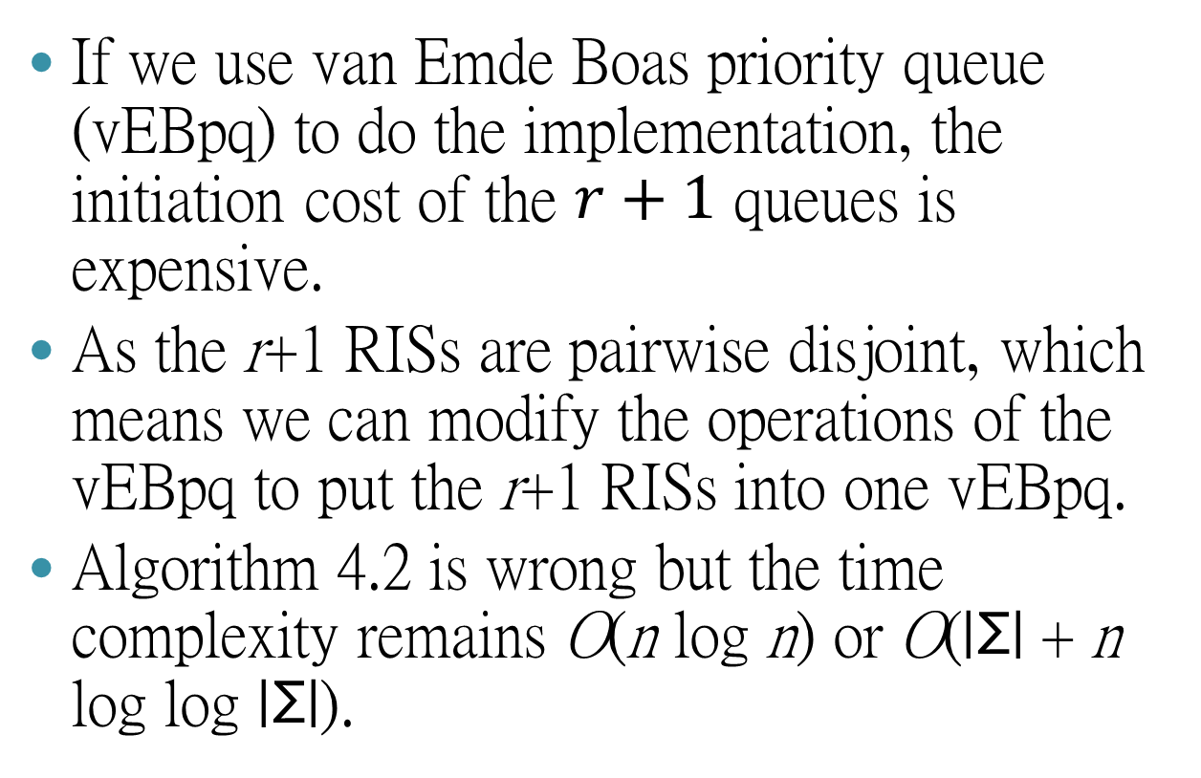
Algorithm 2
If we use van Emde Boas priority queue (vEBpq) to do the implementation, the initiation cost of the $r+1$ queues is expensive.
As the r+1 RISs are pairwise disjoint, which means we can modify the operations of the vEBpq to put the r+1 RISs into one vEBpq.
Algorithm 4.2 is wrong but the time complexity remains O(n log n) or O(|Σ| + n log log |Σ|).

Slide 75
SubSequence Constrained Longest Increasing Subsequence (SSCLIS)
Input: A string S.
Goal: Preprocess S so that we can answer the SSCLIS efficiently.
Constraint: A sequence of positions.
Constraints are given as queries.
S=21624539, C=2, 4 → SSCLIS=12459

Slide 76
Preprocess
To solve this problem, we use a slightly modified RIS called constrained RIS (CRIS).
The first element in the CRIS of S is always a₁ while the ith element in the CRIS of S is the smallest ending number in S to form an LIS of length i starting with a₁.

Slide 77
Preprocess
S=21624539
 | 2 | 1 | 6 | 2 | 4 | 5 | 3 | 9
RIS | 2, X | 1, X | 16, 1 | 12, 1 | 124, 2 | 1245, 4 | 1235, 2 | 12359, 5
2 | 2, X | 2, X | 26, 2 | 26, X | 24, 2 | 245, 4 | 235, 2 | 2359, 5
1 |  | 1, X | 16, 1 | 12, 1 | 124, 2 | 1245, 4 | 1235, 2 | 12359, 5
6 |  |  | 6, X | 6, X | 6, X | 6, X | 6, X | 69, 6
2 |  |  |  | 2, X | 24, 2 | 245, 4 | 235, 2 | 2359, 5
4 |  |  |  |  | 4, X | 45, 4 | 45, X | 459, 5
5 |  |  |  |  |  | 5, X | 5, X | 59, 5
3 |  |  |  |  |  |  | 3, X | 39, 3
9 |  |  |  |  |  |  |  | 9, X

Slide 78
Query
S = 21624539, C = 2, 4 → SSCLIS = 12459
 | 2 | 1 | 6 | 2 | 4 | 5 | 3 | 9
RIS | 2, X | 1, X | 16, 1 | 12, 1 | 124, 2 | 1245, 4 | 1235, 2 | 12359, 5
2 | 2, X | 2, X | 26, 2 | 26, X | 24, 2 | 245, 4 | 235, 2 | 2359, 5
1 |  | 1, X | 16, 1 | 12, 1 | 124, 2 | 1245, 4 | 1235, 2 | 12359, 5
6 |  |  | 6, X | 6, X | 6, X | 6, X | 6, X | 69, 6
2 |  |  |  | 2, X | 24, 2 | 245, 4 | 235, 2 | 2359, 5
4 |  |  |  |  | 4, X | 45, 4 | 45, X | 459, 5
5 |  |  |  |  |  | 5, X | 5, X | 59, 5
3 |  |  |  |  |  |  | 3, X | 39, 3
9 |  |  |  |  |  |  |  | 9, X

