Slide 1
2013 PPLab暑期課程
July, 23, 2013
Hung-Hsin Chen (陳紘昕)

Slide 2
Outline
Classification and regression problem
Principle component analysis (PCA)
Linear discriminant analysis (LDA)
Python scikits.learn library

Slide 3
Machine learning
機器學習 (machine learning) 之主要目的是對給定的一些量測或觀測資料建立一個預測模型(即學習機)。
當有新的輸入資料時，這已經訓練好的預測模型就可以預測出相對的輸出值。(與統計中之回歸曲線類似)
http://m-learning.isu.edu.tw/index.php?gid=6

Slide 4
Machine learning algorithms
Supervised learning: 所有訓練資料的類別均為已知 e.g.: SVM, decision tree, LDA….
Unsupervised learning:所有訓練資料的類別為未知 e.g.: K-means, K-NN,…
Semi-supervised learning:部份訓練資料的類別為已知, e.g.:transductive-SVM…
Reinforcement learning: 透過觀察<->學習來決定行為，常用於自動控制

Slide 5
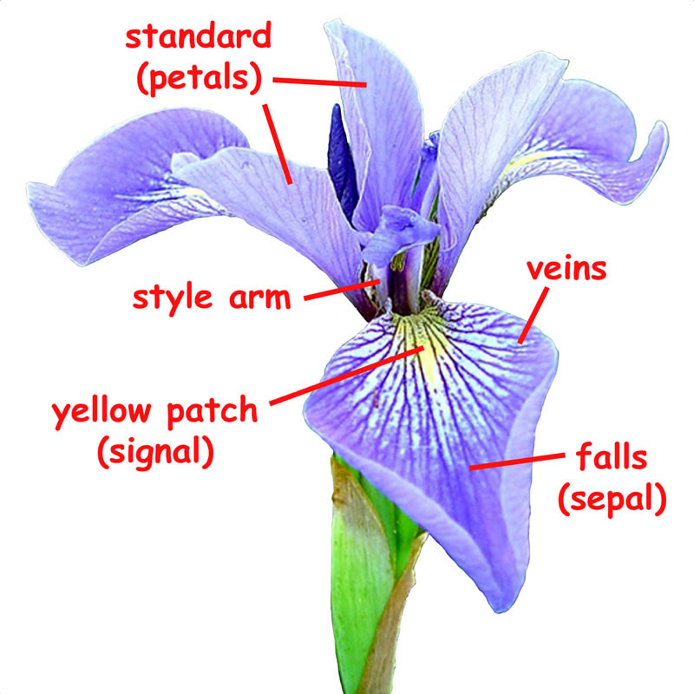
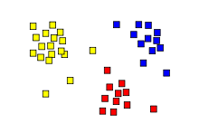
Classification problem
Partial iris flower dataset
Attributes (features) |  |  |  | Class
Sepal Length | Sepal Width | Petal Length | Petal Width | Species
5.1 | 3.5 | 1.4 | 0.2 | setosa
4.9 | 3 | 1.4 | 0.2 | setosa
4.7 | 3.2 | 1.3 | 0.2 | setosa
4.6 | 3.1 | 1.5 | 0.2 | setosa
5 | 3.6 | 1.4 | 0.2 | setosa
0 | 3.2 | 4.7 | 1.4 | versicolor
6.4 | 3.2 | 4.5 | 1.5 | versicolor
6.9 | 3.1 | 4.9 | 1.5 | versicolor
5.5 | 2.3 | 4 | 1.3 | versicolor
6.5 | 2.8 | 4.6 | 1.5 | versicolor
6.3 | 3.3 | 6 | 2.5 | virginica
5.8 | 2.7 | 5.1 | 1.9 | virginica
7.1 | 3 | 5.9 | 2.1 | virginica
6.3 | 2.9 | 5.6 | 1.8 | virginica
6.5 | 3 | 5.8 | 2.2 | Virginica
…
http://en.wikipedia.org/wiki/Iris_flower_data_set

Slide 6
Symbol
M: 大寫粗體為矩陣(matrix)
v: 小寫粗體為向量(vector)
c: 小寫標準體為常量(scalar)
row: 列
Column: 行

Slide 7
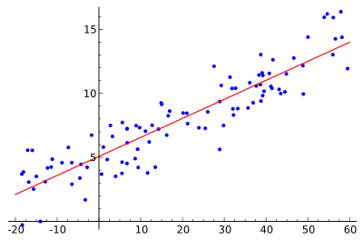
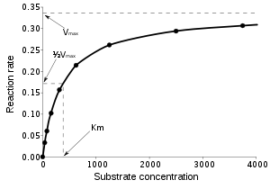
Regression problem
The values of the class are continuous (real number)
Linear regression:
回歸在數學上來說是給定一個點集合，能夠用一條曲線去擬合之，如果這個曲線是一條直線，那就被稱為線性回歸，如果曲線是一條二次曲線，就被稱為二次回歸
Attribute | Class
x₁ | y₁
x₂ | y₂
x₃ | y₃
… | …
x_{n} | y_{n}
Nonlinear regression:

Slide 8
Linear algebra review
Matrix addition & subtraction

Slide 9
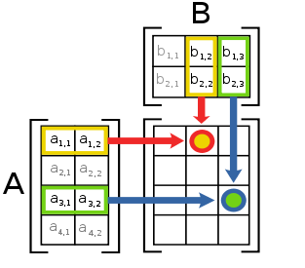
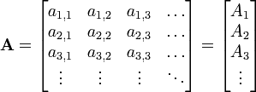
Matrix multiplication
Vector form:
Note: A*B ≠ B*A (矩陣乘法不具交換性)

Slide 10
Matrix scalar multiplication & transpose
Transpose:
Transpose property:
(A^{T})^{T}=A
(A+B)^{T} = A^{T} + B^{T}
(AB)^{T} = B^{T}A^{T}
det(A^{T})= det(A) (square matrix)
c is real number, c^{T}= c
Inner product : a ．b=ab^{T} (or a^{T}b)

Slide 11
Diagonal matrix and trace
Diagonal matrix (除了對角線外均為0):
Trace:
Trace = (-2) + 1 + (-1) = -2

Slide 12
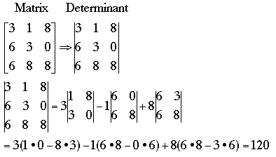
Determinant
Property (square matrix):
det(AB)= det(A) det(B)
If A⁻¹ exist, det(A⁻¹) = 1/det(A)

Slide 13
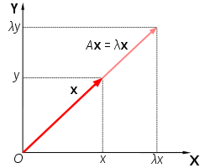
Eigenvector and eigenvalue
Vector x is eigenvector of matrix A, x!=0 if:
Ax = λx
λ is eigenvalue of matrix A
λ=3 or 1, 可再求出對應的eigenvector各為[1, 1]與[-1, 1]
Eigenvalue: 特徵值(台灣), 固有值(日本)

Slide 14
Theorem: λ的特徵向量可形成一個子空間 (Subspace)
若A為一n×n矩陣，且λ為 A的一個特徵值，則對應於λ的所有特徵向量與零向量可構成一個R^{n}的子空間，稱為特徵空間(eigenspace)
Proof:
x₁與x₂為特徵值λ所對應的特徵向量(i.e. $Ax_{1}=λx_{1}, Ax_{2}=λ_{2}x_{2})$
(1) $A\left(x_{1}+x_{2}\right)=Ax_{1}+Ax_{2}=λ_{1}x_{1}+λ_{2}x_{2}=λ\left(x_{1}+x_{2}\right)$ $∴\left(x_{1}+x_{2}\right)$為對應於$λ$之特徵向量
(2) $A\left(cx_{1}\right)=c\left(Ax_{1}\right)=c\left(λ_{1}x_{1}\right)=λ_{1}\left(cx_{1}\right)$ $∴cx_{1}$為對應$λ$之特徵向量

Slide 15
範例 3：平面中的特徵空間
求下列矩陣的特徵值及所對應的特徵空間
解：
假設
位於x軸的向量
特徵值為

Slide 16
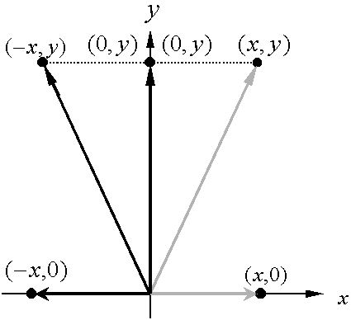
位於y軸的向量
特徵值為
就幾何上來說，矩陣A與在R²中的向量的乘積為對稱於y軸的映射
對應於 的特徵空間為x軸
對應於 的特徵空間為y軸

Slide 17
symmetric matrix
方陣A若相等於自己的轉置矩陣，則稱A為對稱矩陣, 即$A^{T}=A$
範例 1：何者為對稱矩陣

Slide 18
對稱矩陣的性質 (important !!)
令A為一n×n的對稱矩陣。若λ₁及λ₂為A的不同特徵值，則其相對的特徵向量x₁與x₂為正交

Slide 19
Covariance (共變異數)
Two vectors $x, y,E\left(⋅\right):期望值$
Covariance $σ\left(x, y\right)=E\left[\left(x−E\left(x\right))\left(y−E\left(y\right)\right)\right)\right]$ $=E\left(xy−xE\left(y\right)−yE\left(x\right)+E\left(x\right)E(y)\right)$ $=E\left(xy\right)−E\left(x\right)E\left(y\right)−E\left(y\right)E\left(x\right)+E\left(x\right)E\left(y\right)$ $=E\left(xy\right)−E\left(x\right)E(y)$
如果x=y時$σ\left(x,y\right)=var\left(x\right)=E\left(xy\right)−E\left(x\right)E(x)$
 |  |  |  | E(.)
X | 1 | 2 | 3 | 2
y | 5 | 4 | 6 | 5
xy | 5 | 8 | 18 | 10.3
$$σ\left(x, y\right)=σ\left(y,x\right)=10.3−5∗2=0.3$$

Slide 20
Covariance matrix Σ
假設有n個vectors(n筆資料) $x_{1}, x_{2},⋯,x_{n}$
以矩陣表示: $X={\left(x_{1}, x_{2},…,x_{n}\right)}^{T}$
$$Σ=\left[\begin{matrix}σ\left(x_{1},x_{1}\right) & ⋯ & σ\left(x_{1},x_{n}\right) \\ … & … & … \\ & & σ\left(x_{n},x_{n}\right)\end{matrix}\right]=E\left(XX^{T}\right)−E\left(X\right)E\left(X^{T}\right)$$
$$ifx_{1}, ⋯,x_{n}normalized，i.e.E\left(x_{1}\right)=⋯=E\left(x_{n}\right)=0$$
$$then σ=E\left(XX^{T}\right)$$

Slide 21
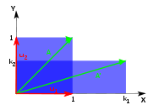
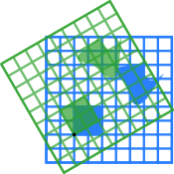
Linear transform
T(cx+y) = cT(x) + T(y), T(x) = Ax
Scaling:
Rotation:
Counter clockwise

Slide 22
Data representation
Partial iris flower data set:
Attributes (features) |  |  |  | Class
Sepal Length | Sepal Width | Petal Length | Petal Width | Species
5.1 | 3.5 | 1.4 | 0.2 | setosa
4.9 | 3 | 1.4 | 0.2 | setosa
4.7 | 3.2 | 1.3 | 0.2 | setosa
4.6 | 3.1 | 1.5 | 0.2 | setosa
5 | 3.6 | 1.4 | 0.2 | setosa
0 | 3.2 | 4.7 | 1.4 | versicolor
6.4 | 3.2 | 4.5 | 1.5 | versicolor
6.9 | 3.1 | 4.9 | 1.5 | versicolor
5.5 | 2.3 | 4 | 1.3 | versicolor
6.5 | 2.8 | 4.6 | 1.5 | versicolor
6.3 | 3.3 | 6 | 2.5 | virginica
5.8 | 2.7 | 5.1 | 1.9 | virginica
7.1 | 3 | 5.9 | 2.1 | virginica
6.3 | 2.9 | 5.6 | 1.8 | virginica
6.5 | 3 | 5.8 | 2.2 | virginica
A point or an instance

Slide 23
Normalization (standardization)
Attributes (features)
Sepal Length | Sepal Width | Petal Length | Petal Width
-0.20 | 1.38 | -1.31 | -1.26
-0.32 | -0.19 | -1.31 | -1.26
-0.43 | 0.44 | -1.36 | -1.26
-0.49 | 0.13 | -1.25 | -1.26
-0.26 | 1.70 | -1.31 | -1.26
-3.17 | 0.44 | 0.44 | 0.18
0.56 | 0.44 | 0.33 | 0.31
0.85 | 0.13 | 0.54 | 0.31
0.04 | -2.39 | 0.07 | 0.06
0.62 | -0.82 | 0.38 | 0.31
0.50 | 0.75 | 1.12 | 1.51
0.21 | -1.13 | 0.65 | 0.79
0.97 | -0.19 | 1.07 | 1.03
0.50 | -0.50 | 0.91 | 0.67
0.62 | -0.19 | 1.02 | 1.15
Avg μ: 0.0 | 0.0 | 0.0 | 0.0
Stdev σ: 1.0 | 1.0 | 1.0 | 1.0
Attributes (features)
Sepal Length | Sepal Width | Petal Length | Petal Width
5.1 | 3.5 | 1.4 | 0.2
4.9 | 3 | 1.4 | 0.2
4.7 | 3.2 | 1.3 | 0.2
4.6 | 3.1 | 1.5 | 0.2
5 | 3.6 | 1.4 | 0.2
0 | 3.2 | 4.7 | 1.4
6.4 | 3.2 | 4.5 | 1.5
6.9 | 3.1 | 4.9 | 1.5
5.5 | 2.3 | 4 | 1.3
6.5 | 2.8 | 4.6 | 1.5
6.3 | 3.3 | 6 | 2.5
5.8 | 2.7 | 5.1 | 1.9
7.1 | 3 | 5.9 | 2.1
6.3 | 2.9 | 5.6 | 1.8
6.5 | 3 | 5.8 | 2.2
Avg μ: 5.44 | 3.06 | 3.87 | 1.25
Stdev σ: 1.71 | 0.32 | 1.89 | 0.83
(X- μ )/ σ

Slide 24
Principle component analysis (PCA)
x_{i}=(x_{i1}, x_{i2},…,x_{id}), i=1,2,…,m (m筆資料，d個特徵)
Goal: find p≦d attributes which containing the maximum amount variance in the data
資料經過旋轉(線性轉換)後，variance會變動
Car | Design+ Performance | Design- Performance
V | 130 | -50
T | 130 | 50
F | 140 | 0
Stdev | 5.78 | 50
Car | Design | Performance
V | 40 | 90
T | 90 | 40
F | 70 | 70
Stdev | 25.16 | 25.16

Slide 25
Standard inner product
Cauchy–Schwarz_inequality
x
$$<x,v> =\left\|x\right\|\left\|v\right\|cosθ$$
$$<x, v> ≥0, if 0≤θ≤\frac{π}{2}$$
θ
v
x=(2,2), ||x|| = 2
v=(3,4), ||v|| = 5
<x,v> = 6 + 8 = 14 = 2*5 *cos θ
cos θ = 1.4, θ =cos⁻¹(1.4)

Slide 26
Vector projection
x
θ
投影長度
單位
v
假設v的長度為1 (i.e. ||V||=1)
即x投影到v的係數為<x, v>=x^{T}v=v^{T}x
x=(2,2), ||x|| = 2
v=(3,4), ||v|| = 5
=>v* = (3/5, 4/5)
<x, v*> = 14/5
x project to v: 14/5*(3/5, 4/5)

Slide 27
Variance
We projected all normalized points X₁, X₂,…,X_{m} to normalized vector V
Coefficient: V^{T}X₁, V^{T}X₂,…, V^{T}X_{m}
_{投影後資料的變異數:}
Σ: covariance matrix of all points

Slide 28
Original data:
Normalized data:
Car | Design | Performance | Space
A | 25 | 60 | 58
B | 75 | 35 | 40
C | 50 | 74 | 68
D | 60 | 30 | 40
E | 50 | 80 | 70
F | 80 | 90 | 95
G | 45 | 50 | 50
Avg | 55.00 | 59.86 | 60.14
Stdev | 18.71 | 22.81 | 19.55
Car | Design | Performance | Space
A | -1.60 | 0.01 | -0.11
B | 1.07 | -1.09 | -1.03
C | -0.27 | 0.62 | 0.40
D | 0.27 | -1.31 | -1.03
E | -0.27 | 0.88 | 0.50
F | 1.34 | 1.32 | 1.78
G | -0.53 | -0.43 | -0.52
Avg | 0.00 | 0.00 | 0.00
Stdev | 1.00 | 1.00 | 1.00
Covariance matrix:
Covariance matrix:
350.00 | 5.00 | 74.17
5.00 | 520.14 | 427.02
74.17 | 427.02 | 382.14
1.00 | 0.01 | 0.20
0.01 | 1.00 | 0.96
0.20 | 0.96 | 1.00
Notes:
import numpy as np
import sklearn.preprocessing as pre
#simple method
data = np.array([[25, 60, 58],[75, 35, 40], [50, 74, 68],
[60, 30, 40],[50, 80, 70],[80, 90, 95],
[45, 50, 50]], dtype=np.float64)
x = (data - data.mean(0)) / data.std(0, ddof=1)
print x.mean(0), x.std(0, ddof=1)
print np.cov(x.T)

Slide 29
假設資料投影至normalized vector V: (1/3, 2/3, 2/3 )^{T}
投影(旋轉)前:
投影(旋轉)後:
Car | Design | Performance | Space
A | -1.60 | 0.01 | -0.11
B | 1.07 | -1.09 | -1.03
C | -0.27 | 0.62 | 0.40
D | 0.27 | -1.31 | -1.03
E | -0.27 | 0.88 | 0.50
F | 1.34 | 1.32 | 1.78
G | -0.53 | -0.43 | -0.52
Avg | 0.00 | 0.00 | 0.00
Stdev | 1.00 | 1.00 | 1.00
Car | 1/3*Design+ 2/3*Performance+ 2/3*Space
A | -0.6034
B | -1.0572
C | 0.5923
D | -1.4706
E | 0.8359
F | 2.5153
G | -0.8122
Avg | 0.00
Stdev | 1.3953
1.00 | 0.01 | 0.20
0.01 | 1.00 | 0.96
0.20 | 0.96 | 1.00
(1/3)
(2/3)
(2/3)
1.9467 = (1/3, 2/3, 2/3)
Notes:
v = [1./3, 2./3, 2./3]
print np.dot(x, v)

Slide 30
如何找出投影(旋轉)後，具有最大變異數的方向?

Slide 31
Principal component analysis (PCA)
投影後，變異數為最大值的投影(旋轉)方向:
||v|| = 1 => v^{T}v-1=0
Lagrange multiplier:
Lagrange multiplier介紹
最佳旋轉方向為共變異數矩陣的eigenvector且為unit vector
此eigenvector的λ值(eigenvalue)為所求出λ的最大值

Slide 32
Eigenvalues: 0.023272
Eigenvectors: (0.13868, 0.69254, -0.70792)^{T}
Eigenvalues: 0.995251
Eigenvectors: (0.978264,, -0.010942)^{T}
Eigenvalues: 1.981477
Eigenvectors: (0.15417, 0.69102, 0.70621)^{T}
Covariance matrix:
1.00 | 0.01 | 0.20
0.01 | 1.00 | 0.96
0.20 | 0.96 | 1.00
Normalized data:
Car | 0.15417*Design+ 0.69102*Performance+ 0.70621*Space
A | -0.3203
B | -1.3160
C | 0.6711
D | -1.5911
E | 0.9252
F | 2.3785
G | -0.7474
Avg | 0
Stdev (n-1) | 1.4076
Car | Design | Performance | Space
A | -1.60 | 0.01 | -0.11
B | 1.07 | -1.09 | -1.03
C | -0.27 | 0.62 | 0.40
D | 0.27 | -1.31 | -1.03
E | -0.27 | 0.88 | 0.50
F | 1.34 | 1.32 | 1.78
G | -0.53 | -0.43 | -0.52
Avg | 0.00 | 0.00 | 0.00
Stdev(n-1) | 1.00 | 1.00 | 1.00
Notes:
covmtx = np.cov(x.T)
eval, evec = np.linalg.eig(covmtx)
print eval, evec
print np.dot(x, evec[:, 0])

Slide 33
任意兩個eigenvectors均為正交(orthogonal) (i.e. <v_{i}, v_{j}>=0 if i is not equal to j)
所以與最大投影方向正交，且變異數為第二大投影方向，即為covariace matrix中第二大eigenvalue所對應的eigenvector。
以此類推
Eigenvalues: 0.995251
Eigenvectors: (0.978264, -0.207074, -0.010942)^{T}
Eigenvalues: 0.023272
Eigenvectors: (0.13868, 0.69254, -0.70792)^{T}
Car | 0.978264*Design+ (-0.207074)*Performance+ (-0.010942)*Space
A | -1.56881
B | 1.28278
C | -0.39426
D | 0.54382
E | -0.44986
F | 1.01407
G | -0.42773
Avg | 0
Stdev | 0.99762
Car | 0.13868*Design+ 0.69254*Performance+ (-0.70792)*Space
A | -0.1404378
B | 0.1228879
C | 0.1078619
D | -0.1401297
E | 0.2176299
F | -0.1616754
G | -0.0061367
Avg | 0
Stdev | 0.15255
Notes:
print np.dot(evec, evec.T)

Slide 34
Contribution of the components
資料分散程度 = 不同主成份變異數之和
主成份對資料的貢獻程度 = 主成份的變異數/資料分散程度
Eigen- value | Eigenvector |  |  | Stdev (n-1) | Variance (n-1) | contrib. | cumulative contrib.
1.981477 | 0.15417 | 0.69102 | 0.70621 | 1.408 | 1.98133 | 66.05% | 66.05%
0.995251 | 0.97826 | -0.20707 | -0.01094 | 0.998 | 0.99524 | 33.18% | 99.22%
0.023272 | 0.13868 | 0.69254 | -0.70792 | 0.153 | 0.023271 | 0.78% | 100.00%
Notes:
print np.dot(x, evec).var(0, ddof=1)

Slide 35
Scikit.learn PCA module
import numpy as np
import sklearn.decomposition as decomp
data = np.array([[25, 60, 58],[75, 35, 40], [50, 74, 68],
[60, 30, 40],[50, 80, 70],[80, 90, 95],
[45, 50, 50]], dtype=np.float64)
x = (data - data.mean(0)) / data.std(0, ddof=1)
pca = decomp.PCA()
results = pca.fit_transform(x)
print results
print pca.explained_variance_
‘’‘投影後的結果 results:
[[-0.32030663 -1.56880996 0.14043785]
[-1.31600878 1.2827751 -0.12288786]
[ 0.67115598 -0.39426102 -0.10786191]
[-1.5911145 0.54381675 0.14012974]
[ 0.92520128 -0.44985789 -0.21762992]
[ 2.37856089 1.01406517 0.16167543]
[-0.74748824 -0.42772814 0.00613666]]
'''
'''
此處計算variance為unibias
[ 1.69840845 0.85307239 0.01994773]
'''

Slide 36
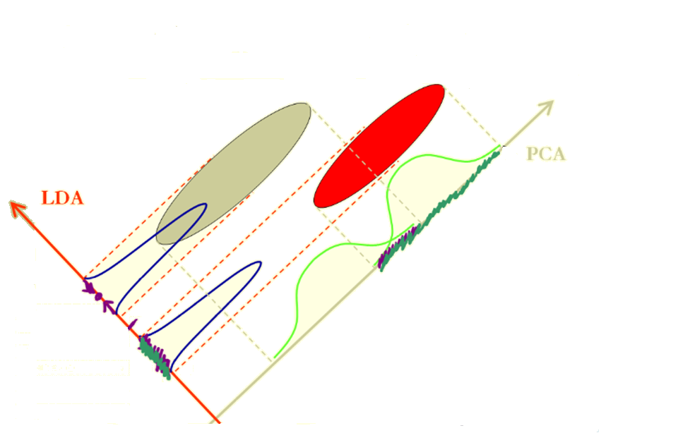
Linear discriminant analysis (LDA)
也稱Fisher linear discriminant (FLD)
PCA是將資料投影(旋轉)至variance最大的方向，但不一定是分類效果最佳的方向。
LDA是將資料投影（旋轉）至分類效果最佳的方向

Slide 37
Symbol
L : number of classes (總類別數)
n_{i}: number of samples in class i (第i個類別的資料筆數)
n : number of all samples (全部類別數)
x^{(i)}_{j}: the j-th sample in class I (在第i個類別的第j筆資料)
所以第i個類別有x^{(i)}₁,x^{(i)}₂,…,x^{(i)}_{ni}個points

Slide 38
Projection
We projected all points to vector v
Coefficients: 類別1: v^{T}x⁽¹⁾₁,v^{T}x⁽¹⁾₂,…,v^{T}x⁽¹⁾_{n1}, … 類別L: v^{T}x^{(L)}₁,v^{T}x^{(L)}₂,…,v^{T}x^{(L)}_{Nc}
投影（旋轉）後，第i類的中心點之係數值：

Slide 39
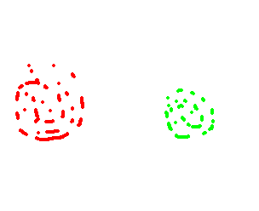
Within & between class scatter
Within-class
Within-class
Class 1
Class 2
Between-class
V
Within-class scatter指的是同一類別內資料的分散程度
Between-class scatter指的是不同類別間資料的分散程度

Slide 40
Between class scatter matrix
The sum of square –distance between class means
matrix

Slide 41
Between class scatter matrix
matrix
m_{x}: 每個類別的中心點加權之後的中心點

Slide 42
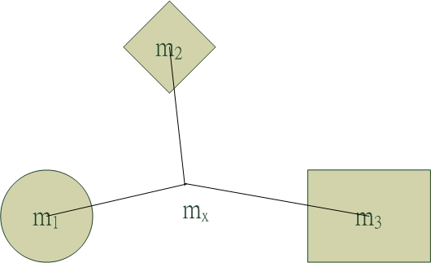
Car | Design | Performance | Space | Sell
A | 25 | 60 | 58 | Bad
B | 75 | 35 | 40 | Middle
C | 50 | 74 | 68 | Middle
D | 60 | 30 | 40 | Bad
E | 50 | 80 | 70 | Good
F | 80 | 90 | 95 | Good
G | 45 | 50 | 50 | Middle
 | Percentage | Middle point
Good | 28.57% | 65.00 | 85.00 | 82.50
Middle | 42.86% | 56.67 | 53.00 | 52.67
Bad | 28.57% | 42.50 | 45.00 | 49.00
Weight middle point (m_{x}) |  | 55.00 | 59.86 | 60.14

Slide 43
Within class scatter matrix
The sum of all class-variances is:

Slide 44
Car | Design | Performance | Space | Sell
E | 50 | 80 | 70 | Good
F | 80 | 90 | 95 | Good
middle point | 65 | 85 | 82.5
B | 75 | 35 | 40 | Middle
C | 50 | 74 | 68 | Middle
G | 45 | 50 | 50 | Middle
middle point | 56.67 | 53 | 52.67
A | 25 | 60 | 58 | Bad
D | 60 | 30 | 40 | Bad
middle point | 42.5 | 45 | 49

Slide 45
Multiclass linear discriminant analysis
投影(旋轉)後，能夠將各類別分的最開的向量v如下:
(組間差距/組內差距)的最大化
Lagrange multiplier:
最佳旋轉方向v為最大eigenvalue所對應之eigenvector

Slide 46
Eigenvalue: 7.414
Eigenvector( -0.301, -0.720, 0.624)
Eigenvalue: 0.483
Eigenvector: (-0.187, -0.563, 0.804)
Eigenvalue: 0
Eigenvector: (-0.215, 0.695, -0.685)
因此將三維資料投影到由
( -0.301, -0.720, 0.624)與
(-0.187, -0.563, 0.804)兩向量所形成的平面時，分散效果最佳

Slide 47
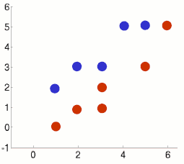
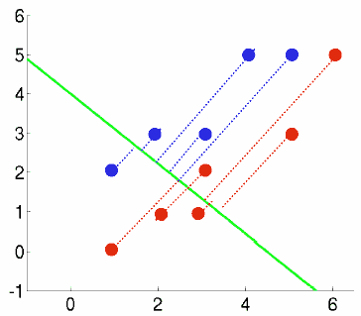
LDA 2-class classifier
Point | Class
(1,2) | 1
(2,3) | 1
(3,3) | 1
(4,5) | 1
(5,5) | 1
(1,0) | -1
(2,1) | -1
(3,1) | -1
(3,2) | -1
(5,3) | -1
(6,5) | -1
M₁ | (3, 3.6)
M₋₁ | (3.3, 2)
M_{x} | (3.18, 2.72)
Σ_{w}=[27.3, 24;
24, 23.2],
Σ_{b}=[0.3, -1.5;
-1.5, 7]
V
V=(-0.67,0.75), λ₁=4.6
λ₂=0,
這表示二維資料最多取得一個最佳旋轉方向
Notes:
c1=[1 2;2 3;3 3;4 5;5 5]’
c2=[1 0;2 1;3 1;3 2;5 3;6 5]‘
m1=mean(c1,'c')
m2=mean(c2,'c')
m=(m1*5+m2*6)/11
c1_m1=c1-mtlb_repmat(m1,1,5)
S1=c1_m1*c1_m1’
c2_m2=c2-mtlb_repmat(m2,1,6)
S2=c2_m2*c2_m2’
Sw=S1+S2
Sb=5*(m1-m)*(m1-m)'+6*(m2-m)*(m2-m)‘
[V,D] = mtlb_eig(inv(Sw)*Sb)

Slide 48
import numpy as np
import numpy.linalg as la
x1 = np.matrix('1.0, 2.0; 2.0, 3.0; 3.0, 3.0; 4.0, 5.0; 5.0, 5.0')
x2 = np.matrix('1.0, 0.0; 2.0, 1.0; 3.0, 1.0; 3.0, 2.0; 5.0, 3.0;6.0, 5.0')
totalnum = float(len(x1)+len(x2))
m1= x1.mean(axis=0)
m2 =x2.mean(axis=0)
mx = len(x1)/totalnum*m1 + len(x2)/totalnum*m2
print "m1:", m1, "m2:", m2, "mx:", mx
#between class
sigma_b1 = (m1-mx).T*(m1-mx)
sigma_b2 = (m2-mx).T*(m2-mx)
sigma_b = len(x1)/totalnum*sigma_b1 + len(x2)/totalnum*sigma_b2
print "between mtx:\n",sigma_b
#within class
sigma_w1 = sum( [(pt-m1).T*(pt-m1) for pt in x1])
sigma_w2 = sum( [(pt-m2).T*(pt-m2) for pt in x2])
sigma_w = 1.0/totalnum * (sigma_w1+sigma_w2)
print "within mtx:\n", sigma_w
#solve eigenvalue for np.inv(sigma_w)*sigma_b
print "eigens:\n",la.eig(la.inv(sigma_w)*sigma_b)

Slide 49
W
V
LDA分析後，兩類別分得更開，但各自類別卻縮的較近
可利用與v正交的向量w為分類函數(linear discriminant function, f(x) = <w, x>+c)
未知類別的點x代入W計算，計算值>0為藍色類別, 計算值<0為紅色類別)
Notes:
c1=[1 2;2 3;3 3;4 5;5 5]’
c2=[1 0;2 1;3 1;3 2;5 3;6 5]‘
m1=mean(c1,'c')
m2=mean(c2,'c')
m=(m1*5+m2*6)/11
c1_m1=c1-mtlb_repmat(m1,1,5)
S1=c1_m1*c1_m1’
c2_m2=c2-mtlb_repmat(m2,1,6)
S2=c2_m2*c2_m2’
Sw=S1+S2
Sb=5*(m1-m)*(m1-m)'+6*(m2-m)*(m2-m)‘
[V,D] = mtlb_eig(inv(Sw)*Sb)

Slide 50
Linear discriminant function
surface: w₁x₁+w₂x₂+…+w_{n}x_{n}+c = 0 => w^{T}x+c=0 (vector form)
向量v為(-0.67,0.75), 因為w與v正交，所以向量w為(0.75, 0.67)
假設w通過兩類中心點 (3, 3.6), (3.3, 2)的中點 (3.15, 2.8)
可算出常數c=-(0.75*3.15+0.67*2.8) = 4.2385
Surface: 0.75x₁+0.67x₂-4.2385=0

Slide 51
scikits.learn package LDA example:
import numpy as np
Import sklearn.lda as lda
X = np.array([[-1, -1], [-2, -1], [-3, -2], [1, 1], [2, 1], [3, 2]])
y = np.array([1, 1, 1, 2, 2, 2])
clf = lda.LDA()
clf.fit(X, y)
#LDA(priors=None, n_components=None)
print clf.predict([[-0.8, -1]])
#[1]

Slide 52
Thank you!!

