Slide 1
DTW & UCR
Presenter: Che-Jui Hsu(許哲睿)
Date: 2013/7/28

Slide 2
Dynamic Time Warping
定義：Dynamic time warping (DTW) is an algorithm for measuring similarity between two sequences which may vary in time or speed.
Notes:
Ref: http://en.wikipedia.org/wiki/Dynamic_time_warping

Slide 3
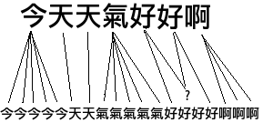
Notes:
Ref: http://blog.mckelv.in/articles/1453.html

Slide 4
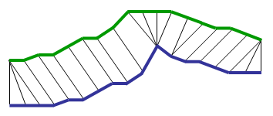
Notes:
Ref: http://www.mblondel.org/journal/2009/08/31/dynamic-time-warping-theory/

Slide 5
Q
C
Warping Path
Notes:
Ref: http://www.google.com/url?sa=t&rct=j&q=lb_keogh&source=web&cd=2&ved=0CDMQFjAB&url=http%3A%2F%2Fwww.cise.ufl.edu%2Fclass%2Fcis4930fa07ilg%2Fslides%2Fdtw.ppt&ei=mTH1UeX6B8qPkgWvv4H4BQ&usg=AFQjCNGUA1lfcli-rD46hrqVSBwD_pJ3aQ

Slide 6
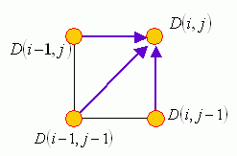
Method
$D\left(i, j\right)=\text{cost}\left(i, j\right)+$ $\min\left(D\left(i−1, j\right),D\left(i, j−1\right),D\left(i,−1 j−1\right)\right)$
Notes:
Ref: http://mirlab.org/jang/books/dcpr/dpDtw.asp?title=8-4%20Dynamic%20Time%20Warping&language=all

Slide 7
Example (1/2)
$Q\left[i\right]=\left\{0.1, 0.3, 0.5, 0.4, 0.2\right\}$
$C\left[j\right]=\left\{0.3, 0.2, 0.4, 0.1, 0.5\right\}$
$cost\left(i, j\right)=\left|Q\left[i\right]−C\left[j\right]\right|$

Slide 8
Example (2/2)
 | 0.1 | 0.3 | 0.5 | 0.4 | 0.2
0.3 | $$0.2+0$$ | $$0+0.2$$ | $$0.2+0.2$$ | $$0.1+0.4$$ | $$0.1+0.5$$
0.2 | $$0.1+0.2$$ | $$0.1+0.2$$ | $$0.3+0.2$$ | $$0.2+0.4$$ | $$0+0.5$$
0.4 | $$0.3+0.3$$ | $$0.1+0.3$$ | $$0.1+0.3$$ | $$0+0.4$$ | $$0.2+0.4$$
0.1 | $$0+0.6$$ | $$0.2+0.4$$ | $$0.4+0.4$$ | $$0.3+0.4$$ | $$0.1+0.4$$
0.5 | $$0.4+0.6$$ | $$0.2+0.6$$ | $$0+0.6$$ | $$0.1+0.6$$ | $$0.3+0.5$$
0.1 | 0.3 | 0.5 | 0.4 | 0.2
0.3 | 0.2 | 0.4 | 0.1 | 0.5

Slide 9
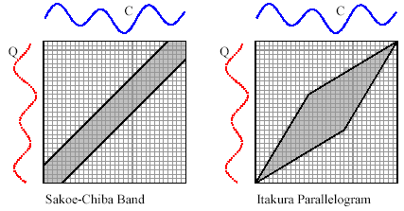
Warping Window
Warping Window
Notes:
Ref: http://www.google.com/url?sa=t&rct=j&q=lb_keogh&source=web&cd=2&ved=0CDMQFjAB&url=http%3A%2F%2Fwww.cise.ufl.edu%2Fclass%2Fcis4930fa07ilg%2Fslides%2Fdtw.ppt&ei=mTH1UeX6B8qPkgWvv4H4BQ&usg=AFQjCNGUA1lfcli-rD46hrqVSBwD_pJ3aQ

Slide 10
Lower Bounding
功用：用來減少需要計算 DTW 的時間序列以加快整個運算流程
要求：
計算速度快
有效篩選掉不需要計算的時間序列
$\text{LB}≥{\text{DTW}}_{best}⟹\text{不用計算}$

Slide 11
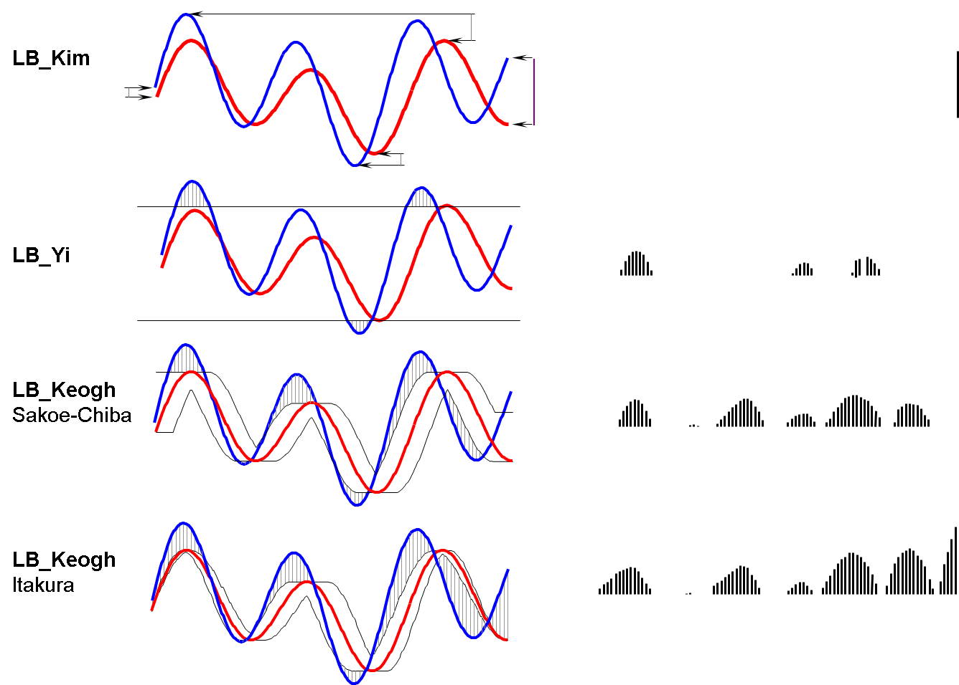
Notes:
Ref: http://www.google.com/url?sa=t&rct=j&q=lb_keogh&source=web&cd=2&ved=0CDMQFjAB&url=http%3A%2F%2Fwww.cise.ufl.edu%2Fclass%2Fcis4930fa07ilg%2Fslides%2Fdtw.ppt&ei=mTH1UeX6B8qPkgWvv4H4BQ&usg=AFQjCNGUA1lfcli-rD46hrqVSBwD_pJ3aQ

Slide 12
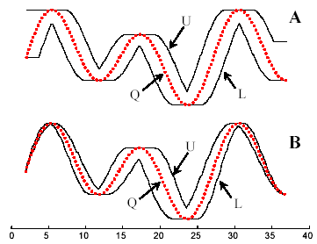
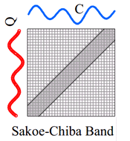
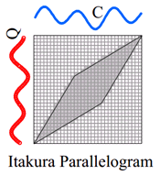
${LB}_{Keogh}$ (1/2)
$U_{i}=\max\left(q_{i−r} :q_{i+r}\right)$
$L_{i}=\min\left(q_{i−r} :q_{i+r}\right)$

Slide 13
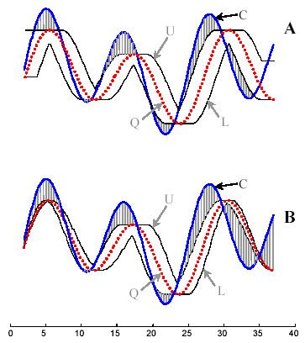
${LB}_{Keogh}$ (2/2)

Slide 14
UCR Time Series
http://www.cs.ucr.edu/~eamonn/time_series_data/

Slide 15
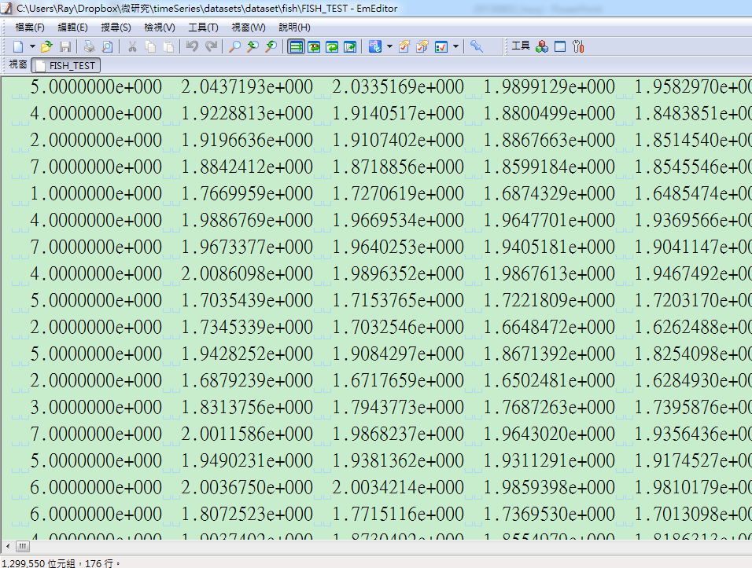
Cluster number
Notes:
Ref: http://www.cs.ucr.edu/~eamonn/time_series_data/

Slide 16
Video Retrieval
Notes:
Ref: http://www.cs.ucr.edu/~eamonn/DTW_myths.pdf

Slide 17
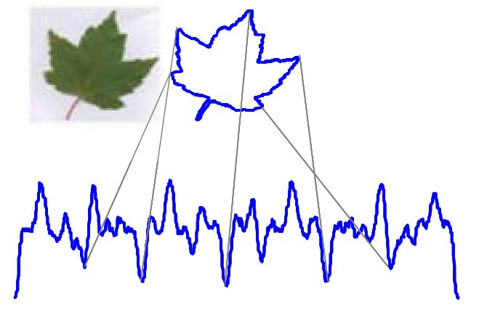
Image Retrieval
Notes:
Ref: http://www.cs.ucr.edu/~eamonn/DTW_myths.pdf

Slide 18
Handwriting Retrieval
Notes:
Ref: http://www.cs.ucr.edu/~eamonn/DTW_myths.pdf

Slide 19
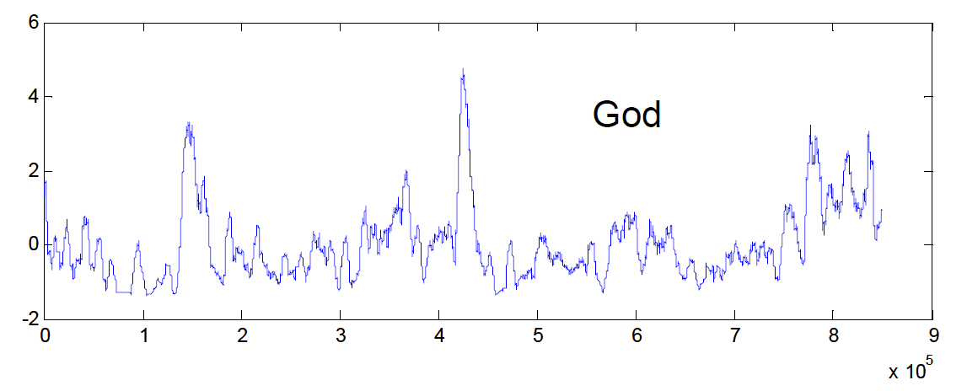
Text Mining
“In the beginning God created the heaven and the earth” => “0001000000”
Notes:
Ref: http://www.cs.ucr.edu/~eamonn/DTW_myths.pdf

